Slide 1

基于梦飞巡天望远镜对M33变源暂现源的多波段系统监测研究
Speaker: Yu Pan
Supervisor: Xiaowei Liu
2024/08/05
SWIFAR @ YNU

Slide 2
OUTLINES
Background
The Advantage and Data of Mephisto
Image subtraction
Result
Summary

Slide 3
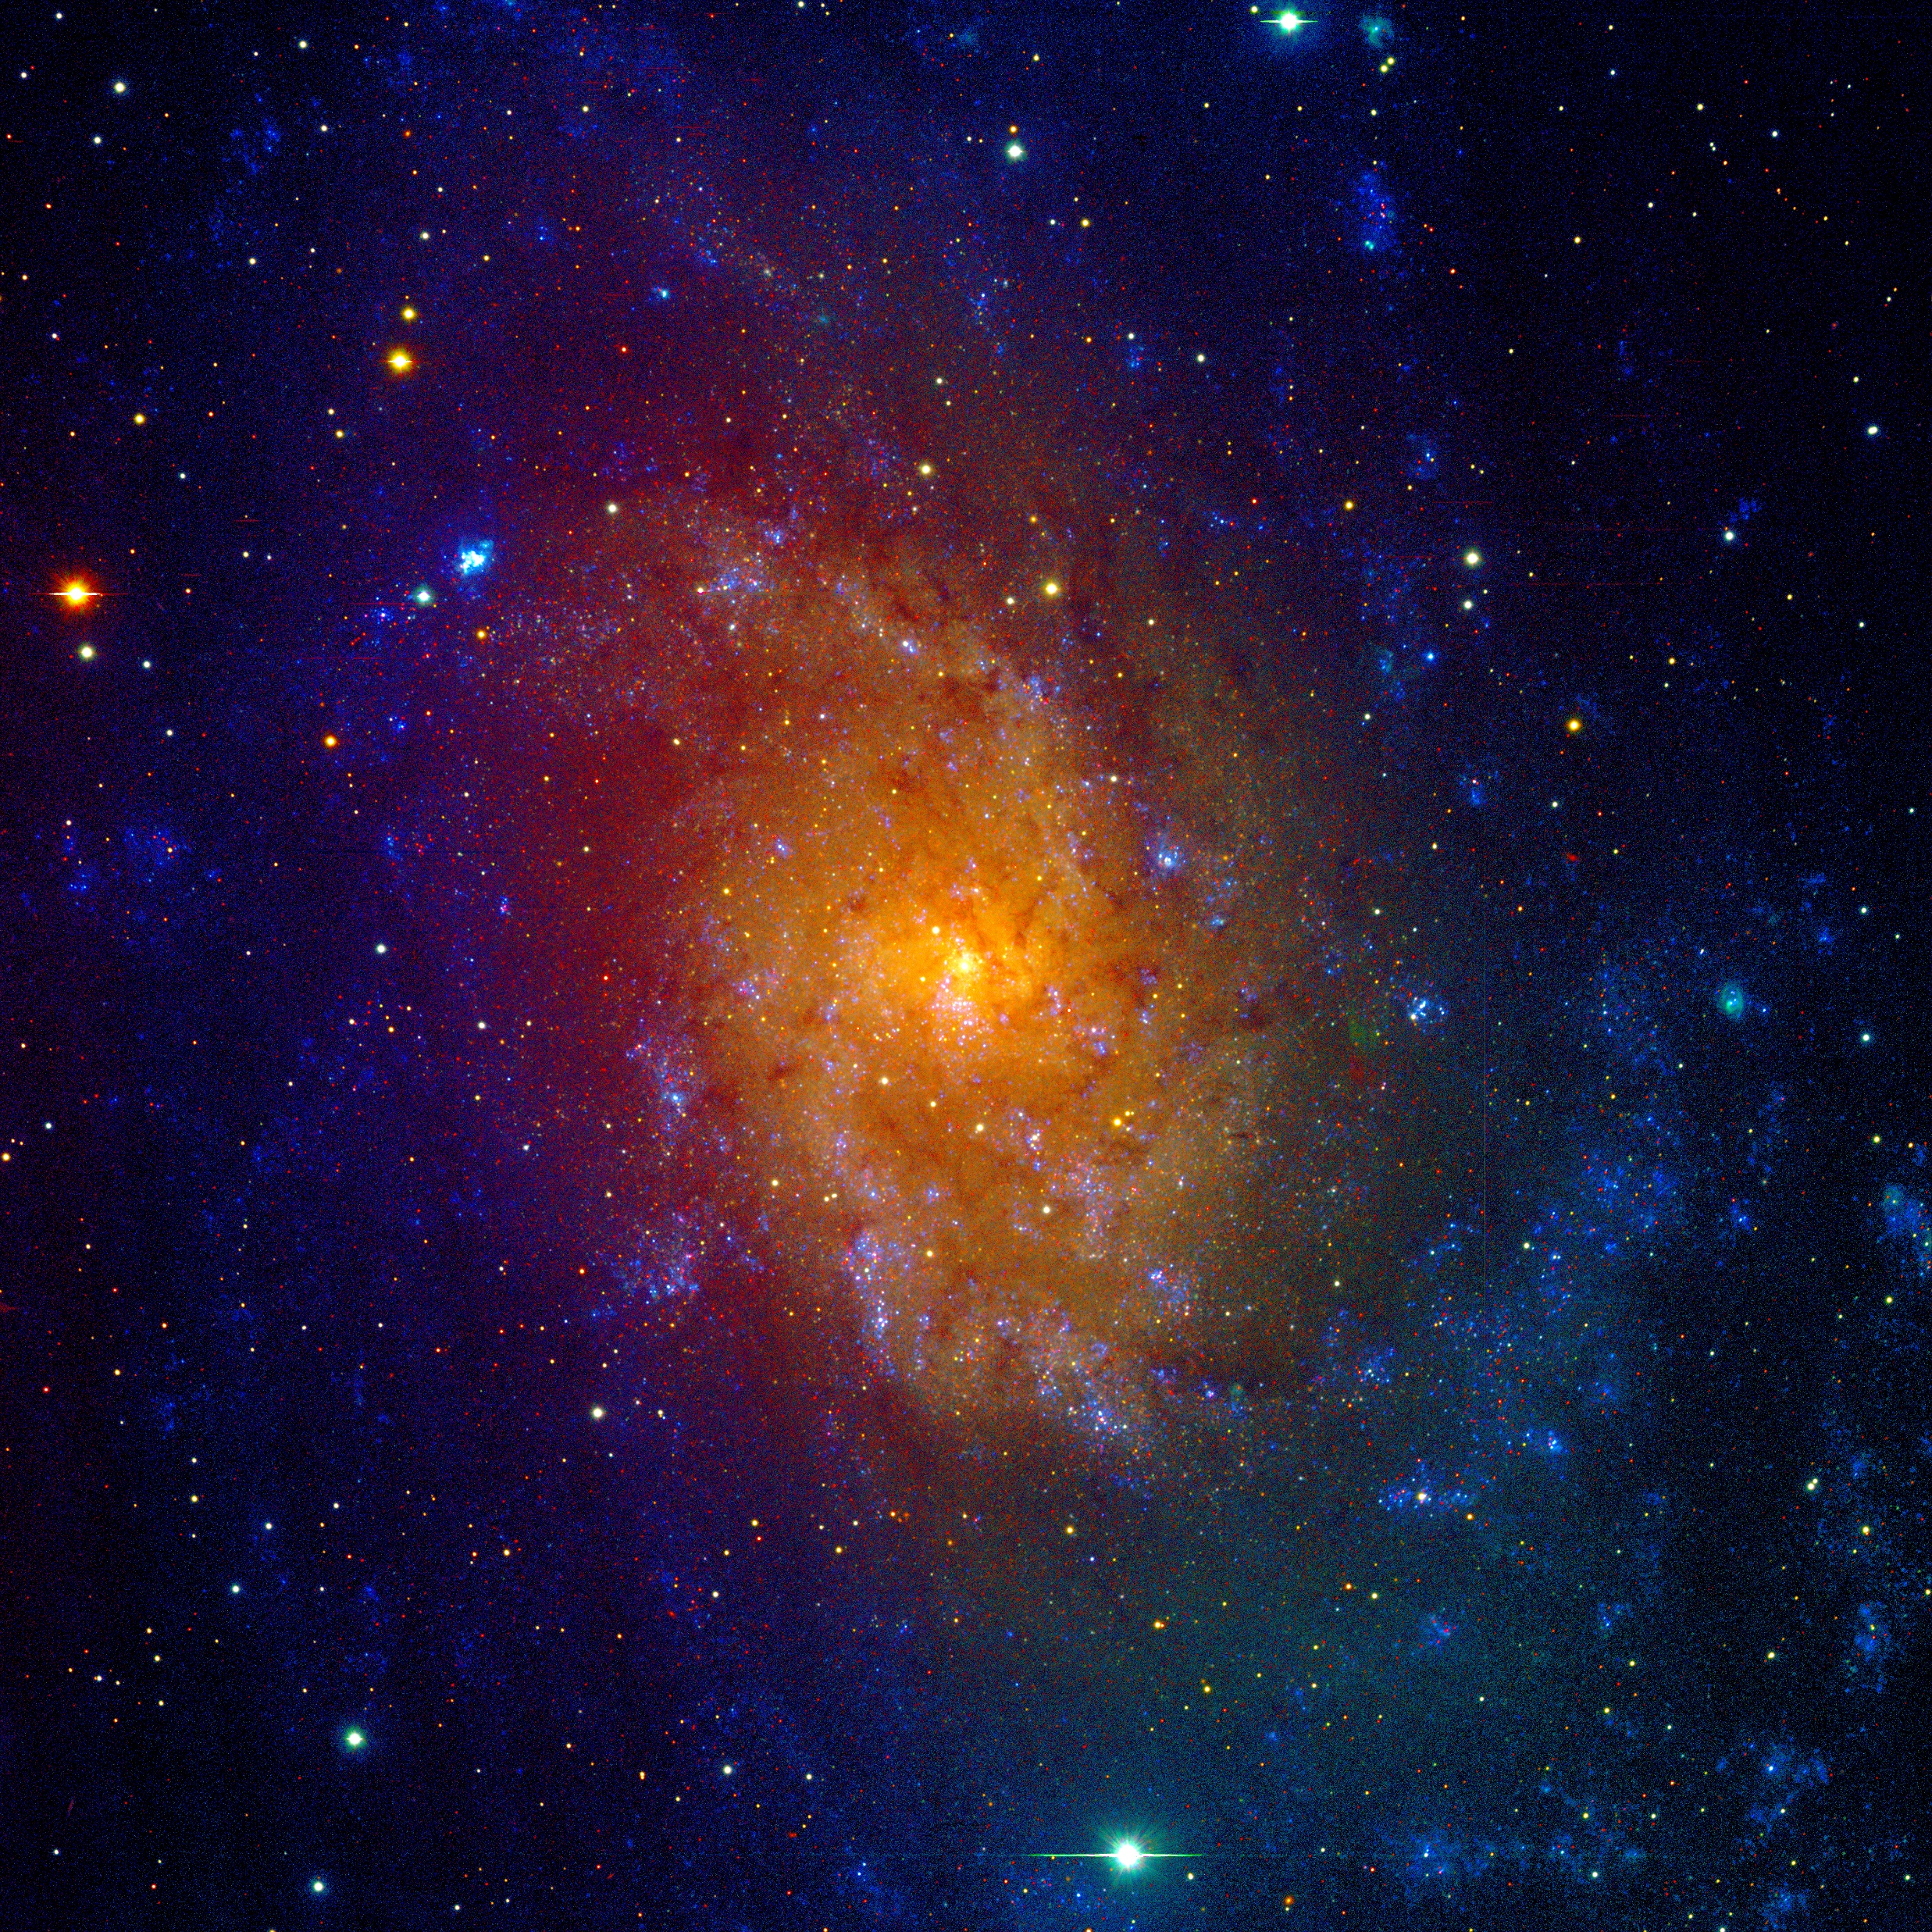
Background
The importance of studying variables in nearby galaxies
Galaxies are the cornerstone of the universe, and the formation and evolution of galaxies is one of the frontier topics in the field of astrophysics research in the 21st century.
M33 is the stepping stones in most of the current effort to understand the evolving universe at large scales. Not only is it essential to the calibration of the extragalactic distance scale, but it also constrains population synthesis models for early galaxy formation and evolution. (Macri et al.2001)
Proximity: resolve brighter variable star populations with groundbased telescopes
Simple geometry and as a face-on galaxy: treat all the M33 stars as at the same distance.
Metal rich environment: study metallicity influence on the properties of variables ( Scowcroft et al. (2009)).
Traditionally variable stars have served as one of the prime tools for determining the local distance scale.
Transient detections would help to throw light on the properties of galaxy, in particular its stellar population. (Soraisam et al.2018)
RGB images (ugi) of M33 taken by Mephisto
Host galaxy | Telescope | Distance Moduli | Reference
M33 | FLWO | µ=24.65± 0.12mag | Macri (2001)
M33 | WIYN | µ=24.76±0.02mag | Pellerin (2011)
M33 | CFHT | µ=25.044±0.083mag | Adair (2023)
M33 | HST | µ=24.622±0.030mag | Breuval (2023)
Notes:
星系是宇宙的基石，而星系的形成和演化是21世纪天体物理学研究领域的前沿课题之一。
而m33是目前在大尺度上理解演化宇宙的基石。它不仅对星系外距离尺度的校准至关重要，而且还约束了早期星系形成和演化的星族合成模型。
首先，m33能够用地面望远镜分辨出较亮的变星族，m33是一个face-on星系，因此可以将所有的M33恒星视为在相同的距离上。此外，相比于麦哲伦星系和其他矮星系，M33是一个富金属的环境，可以用来研究金属丰度对变星性质的影响。星系中的一些变源，比如造父变星，可以作为距离指示器，得到星系离我们的距离。一些暂现源的探测可以帮助我们了解星系的属性，特别是它的星族。表格内是一些对m33内变源暂现源的重要研究，右图是用mephisto的ugi波段的图像合成的m33的真彩色图。

Slide 4
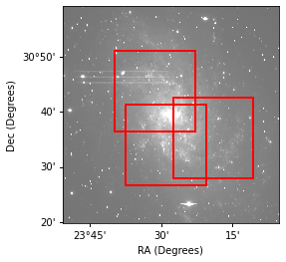
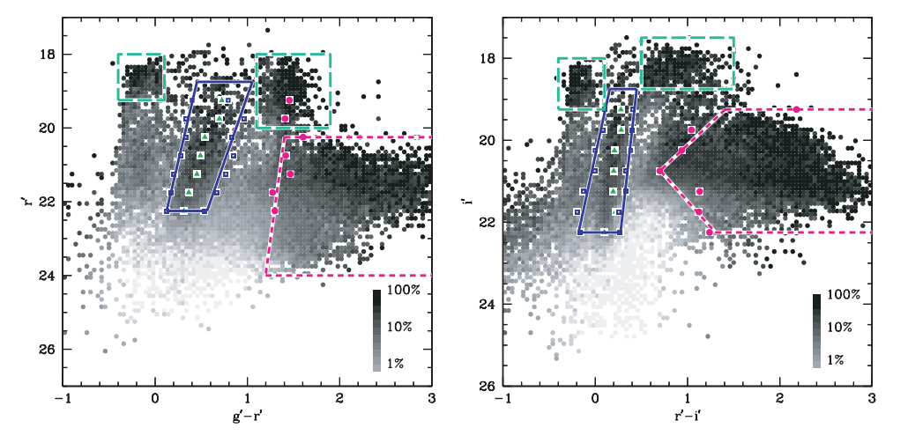
The advantage of Mephisto
Fov: 44’ ×44’
Plate scale: 0.429′′ /pixel
Get ugi / vrz images at the same time.
Hartman et al. 2006
Mosaic g image of M33 obtained with Mephisto.
The red rectangle: the observation of DIRECT project using 1.2-m telescope
The solid lines bound the Cepheid region; the short-dashed lines bound the LPV region; and the long-dashed lines bound the variable blue and red supergiants.
Cepheid IS peak using triangles, its blue and red edges using squares, and the blue edge of the long period variable region using circles.
Notes:
DIRECT 项目是早期研究 M33 星系中变星的重要努力之一。它使用 1 米口径的 FLWO 望远镜。 该项目最初在 M33 中发现了 251 颗造父变星和47颗deb，这在当时是一个相当可观的样本量。这对后续研究 M33 的结构和距离起到了关键作用。（Exposure times were 1200s in B, 900s in V and 600s in I.）(I: 1.8′′; B and V: 2.0′′) （Johnson-Cousins BV I filter）
Direct项目使用的1m望远镜视场为10.8角分乘上10.8角分，mephisto的视场大小为40角分乘上40角分，几乎能完整覆盖整个m33，并且我们能同时获得三个波段的图像，因此具有实时高精度的颜色信息，可以实现对变源暂现源进行快速精确的分类。

Slide 5
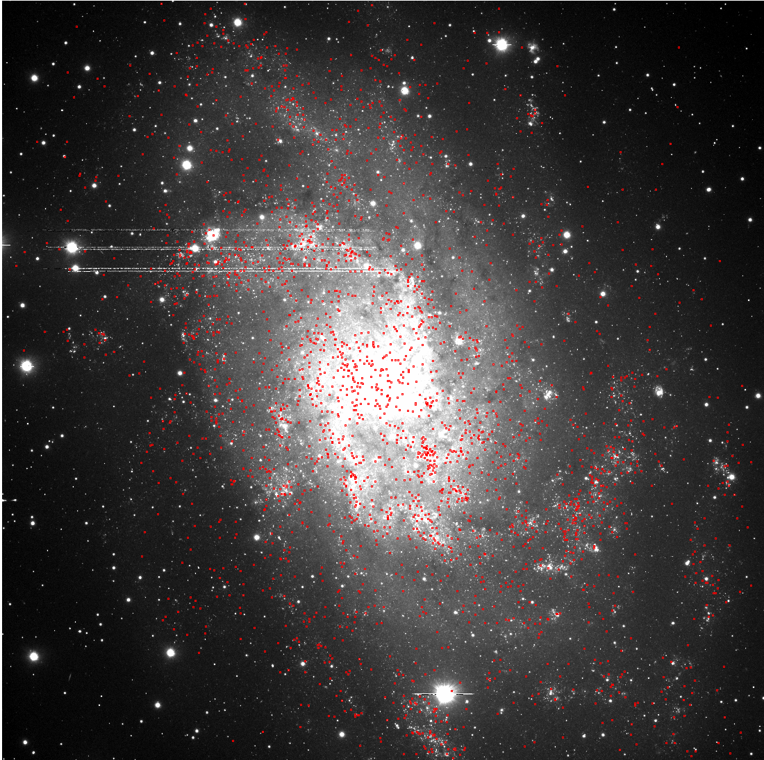
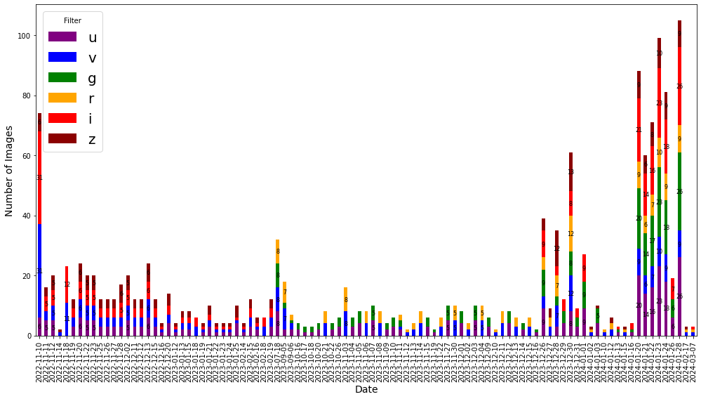
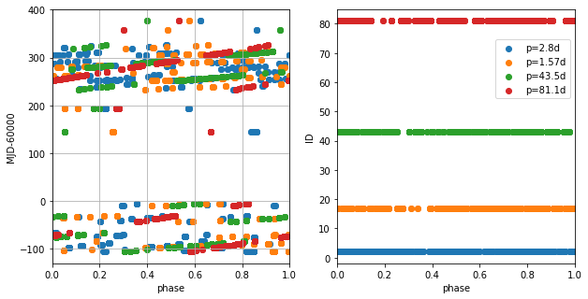
The data of Mephisto
Complete RSG sample from Ren et al.2020
We have a dedicated high-cadence monitoring of the M33, specifically one whose stars can be resolved as much as possible within the sensitivity of the observation system.
The data of M33 were obtained on 97 separate nights between 2022/11/10 and 2024/03/07.
Notes:
我们对 M33 星系进行了专门的高频率监测，特别是对那些在观测系统灵敏度范围内尽可能能被分辨的恒星进行了监测。我们从2022年11月10日至2024年3月7日，一共观测了97天，左下图展示了每天不同波段的观测次数。下图可以看出我们已有的观测，基本上覆盖了星系内不同周期变源的整个相位。

Slide 6
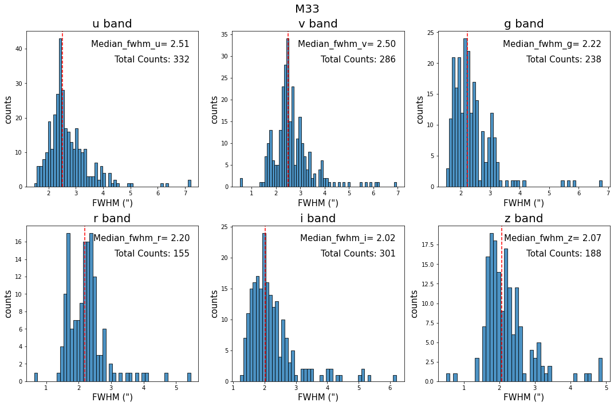
The data of Mephisto
Select images to make template (Hereafter ref.)
Filter | FWHM(“) | Ell
u | 2.2 | 0.15
v | 2.5 | 0.15
g | 2.1 | 0.15
r | 2.2 | 0.15
i | 2.1 | 0.15
z | 2.2 | 0.15
Perform time matching on ugi, select images that were exposed simultaneously, finally match 25 images that were exposed at the same time, and then stack these 25 images (Same as vrz, finally match 19 images)
Notes:
左边的图展示了目前不同波段的观测的一个像质分布，标注了不同波段像质的中值，以及不同波段拍摄图像的总数。由于在早期观测中没有进行像质的调试，因此像质分布不是很均匀，根据每个波段像质的分布情况，我们根据表格中的的挑选标准，选出构建参考图像的科学图像，并对这些科学图像进行时间匹配，选出同时观测的图像。最后在ugi波段挑选出25幅，vrz波段挑选出19幅符合条件的图像，采用加权平均的方法，合成出每个波段最后的参考图像。

Slide 7
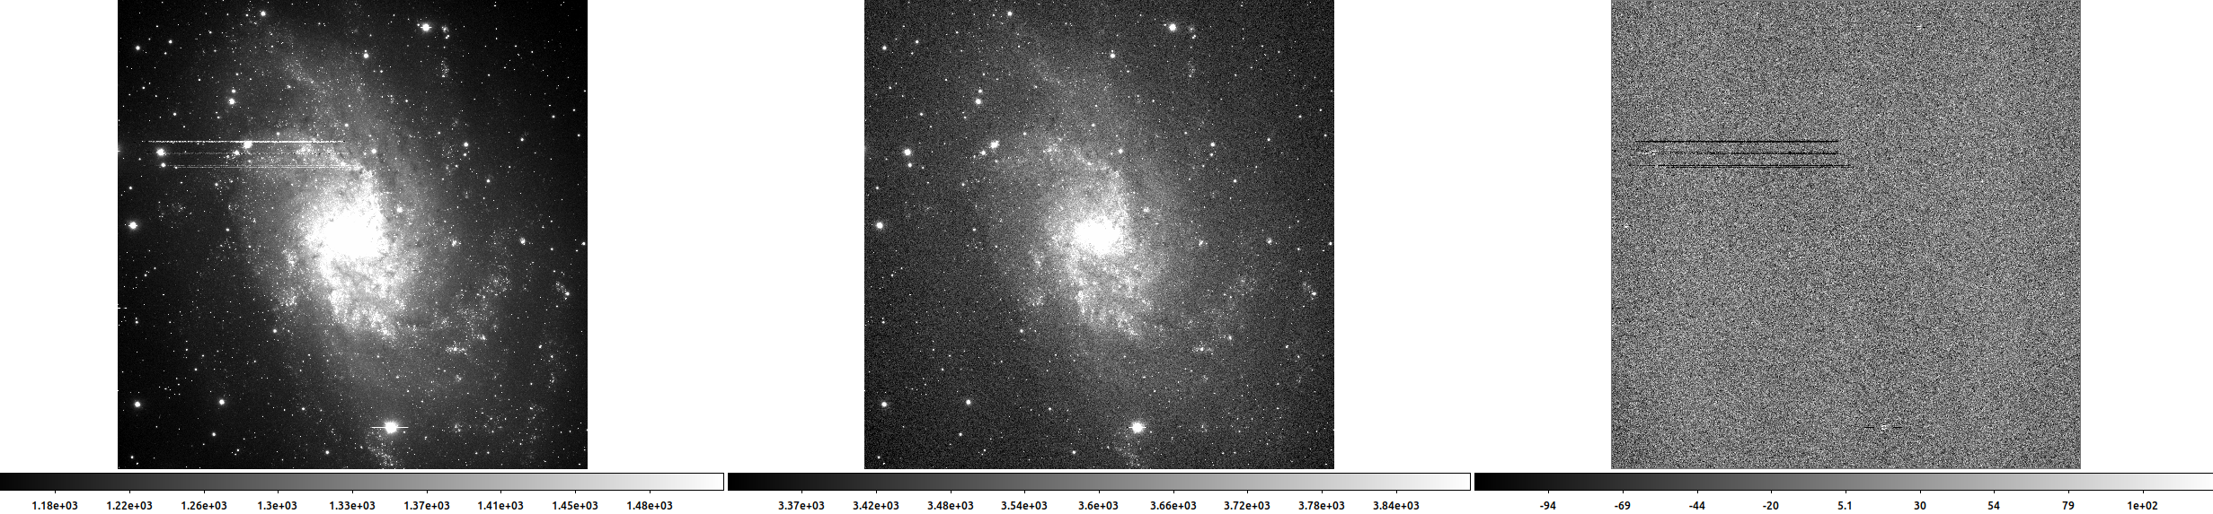
Parameters of Hotpants
Image subtraction
Parameter | Value | Note
r | 7 | convolution kernel half width (pixel)
rss | 17 | Half width of substamp to extract around stars (pixel)
tu | 40000 | upper valid data count of the reference image
iu | 40000 | upper valid data count of the science image
Image position alignment: Remap the reference image into the pixel coordinate system of the science image with Swarp (Bertin et al. (2002))
Flux alignment: We align the flux of the stars in the remaining images with that of the corresponding stars whose signal-to-noise ratios (S/N) > 20, flag =0 and flux >0 in the reference image, and obtain the scale factor.
Ref Sci Diff
Notes:
我们采用图像对减的方法找m33中的变源暂现源。首先是采用swarp把图像的中心重新采样到同一位置处；然后，在参考图和科学图像中选出同一批星，得到两张图的流量比值。然后使用hotpants得到对减图像。右上角是采用的一些hotpants的参数。下图是一个g波段图像对减的例子，最左边是参考图，中间是重采样且做过流量对齐的图像，右边是对减图像。

Slide 8
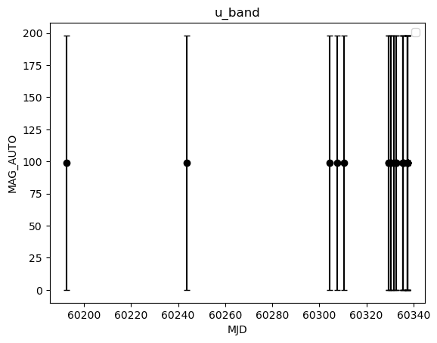
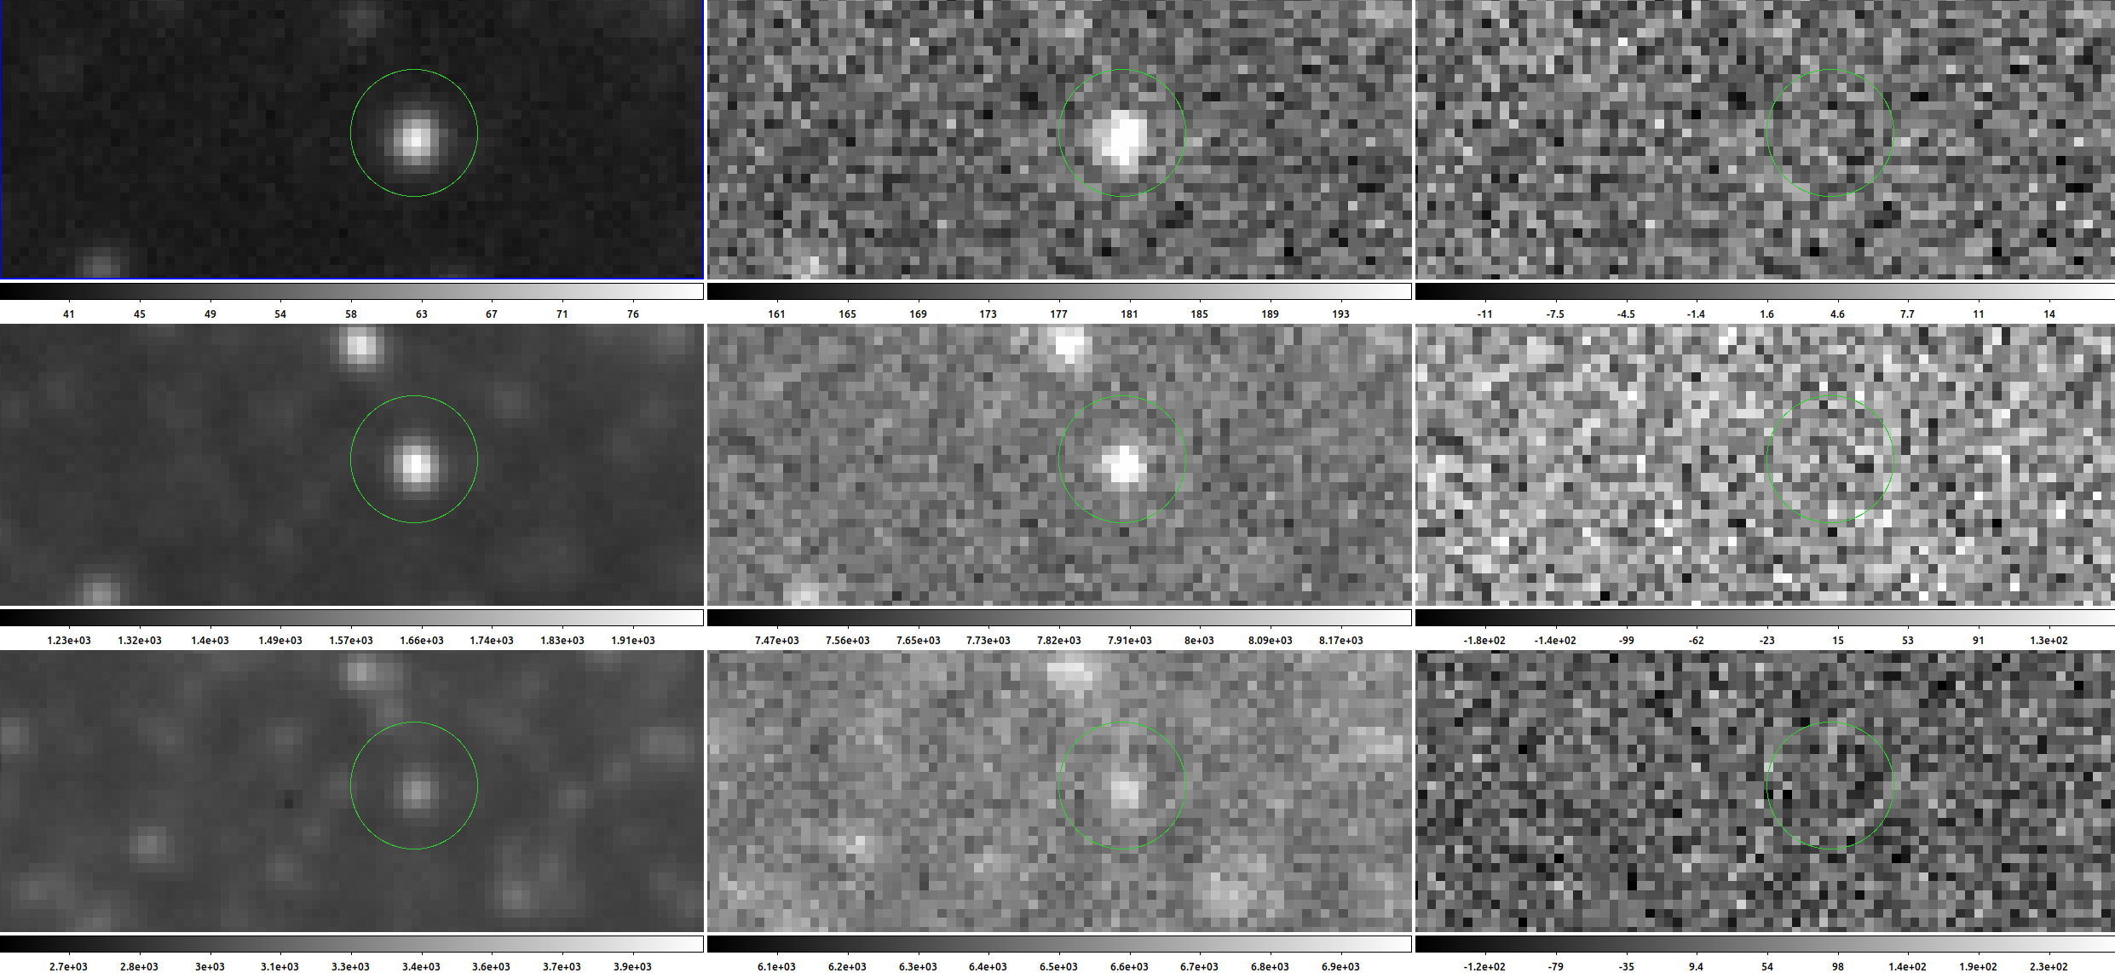
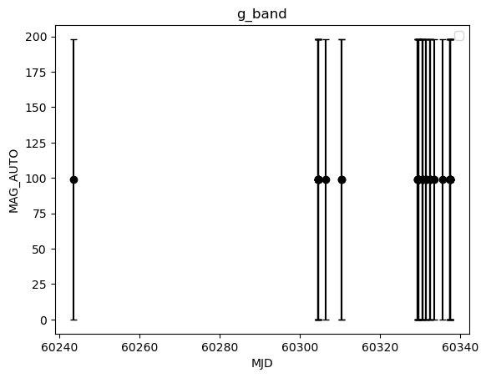
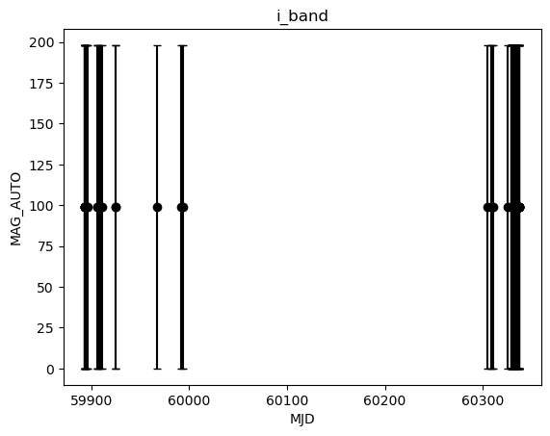
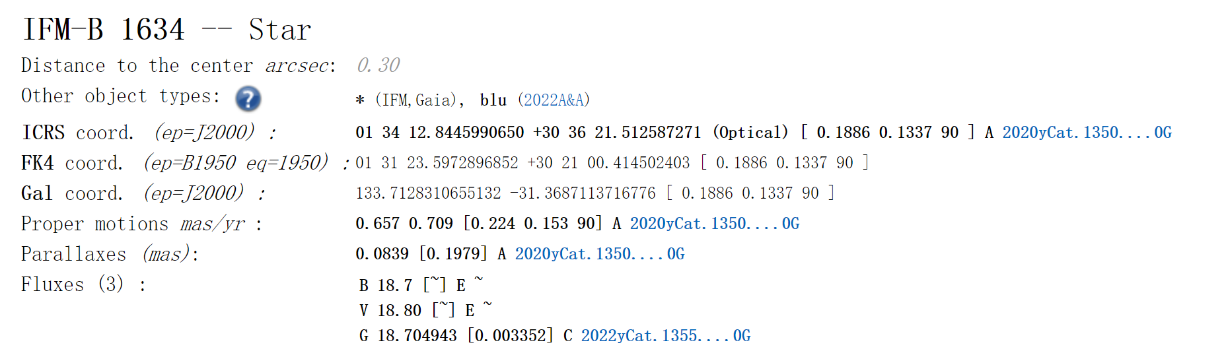
Result
Lightcurves constructed via force photometry on the difference images.
Check star in M33
Ref Sci Diff
u
g
i
Check star information in simbad
Notes:
为了验证hotpants减出来的图像上的残差确实是真实的光变，我们选了一颗check star，这幅图从上往下依次是u、g、i波段，从左往右依次是参考图，科学图，对减图，可以看到基本没有残差。最下面展示了simbad给出这个源的信息，是一个bv星等大约为19等的一颗恒星。右边展示了在对减图上做强制测光得到的光变曲线，可以看到是没有任何光变的。

Slide 9
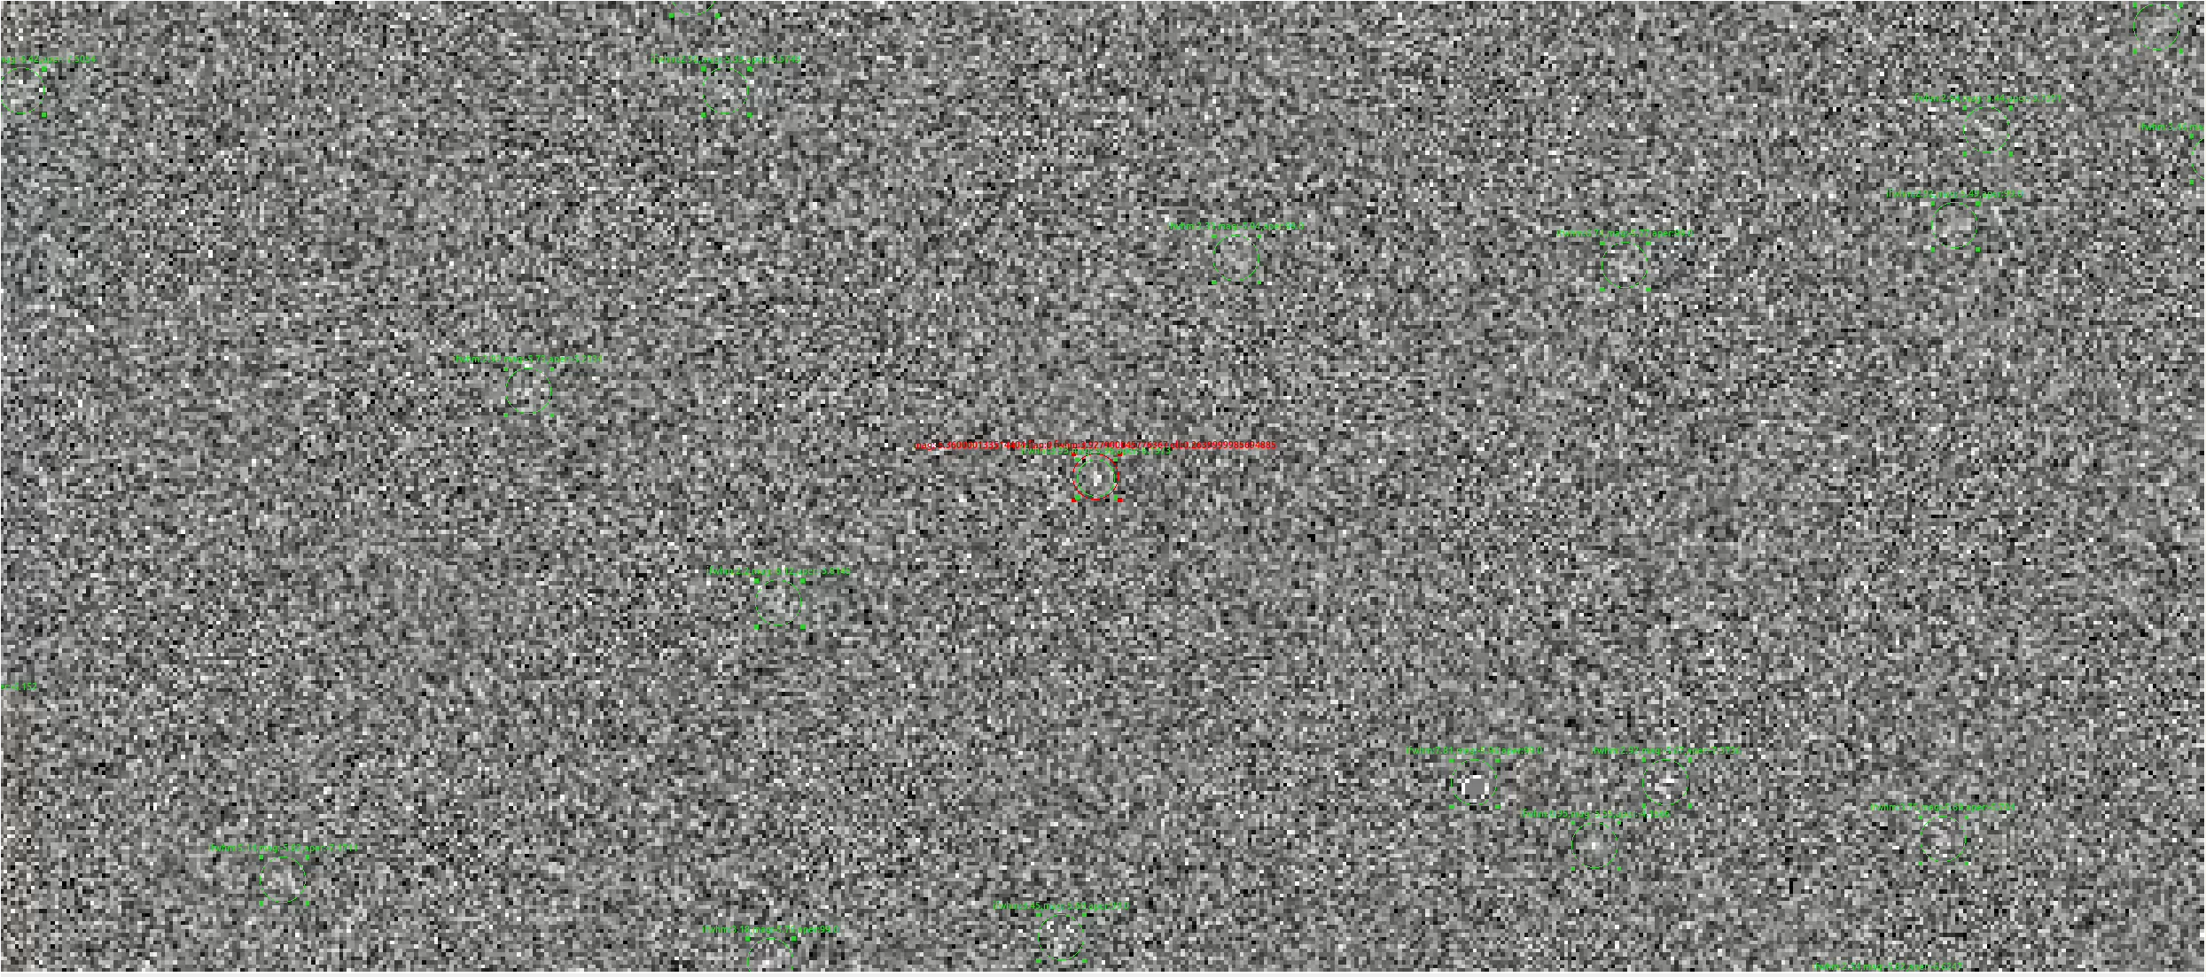
Result
Do aperture photometry in difference images.
Performs some tests to filter out false positive detections：
Cross-match and combine star catalogs from individual bands.
Cross-match the star catalogs of the ugi bands and filter out sources that appear two or more times. (7237)
Cross-match sources that appear two or more times with Simbad. (3049)
ELONGATION< 0.5
ELONGATION> 6)
FLAGS> 0
FWHM_IMAGE< 1
FWHM_IMAGE> 8.8
SNR_WIN< 5
MAG_APER== 99
Red：after filter
Notes:
得到对减图像后，首先是在对减图像上做了孔径测光，然后使用了以下条件筛选了一些假源。这个筛选条件是结合孙等人2022年给出的方法和根据对我们的对减图进行目视审查得到的。 图中的绿圈是直接采用孔径测光得到的源，红圈是使用筛选条件后，选出来的源。把每个波段的星表进行交叉并和，得到三个星表，对这三个星表进行交叉，选出出现两次及两次以上的源，得到最后的星表，把这个表与simbad进行交叉。

Slide 10
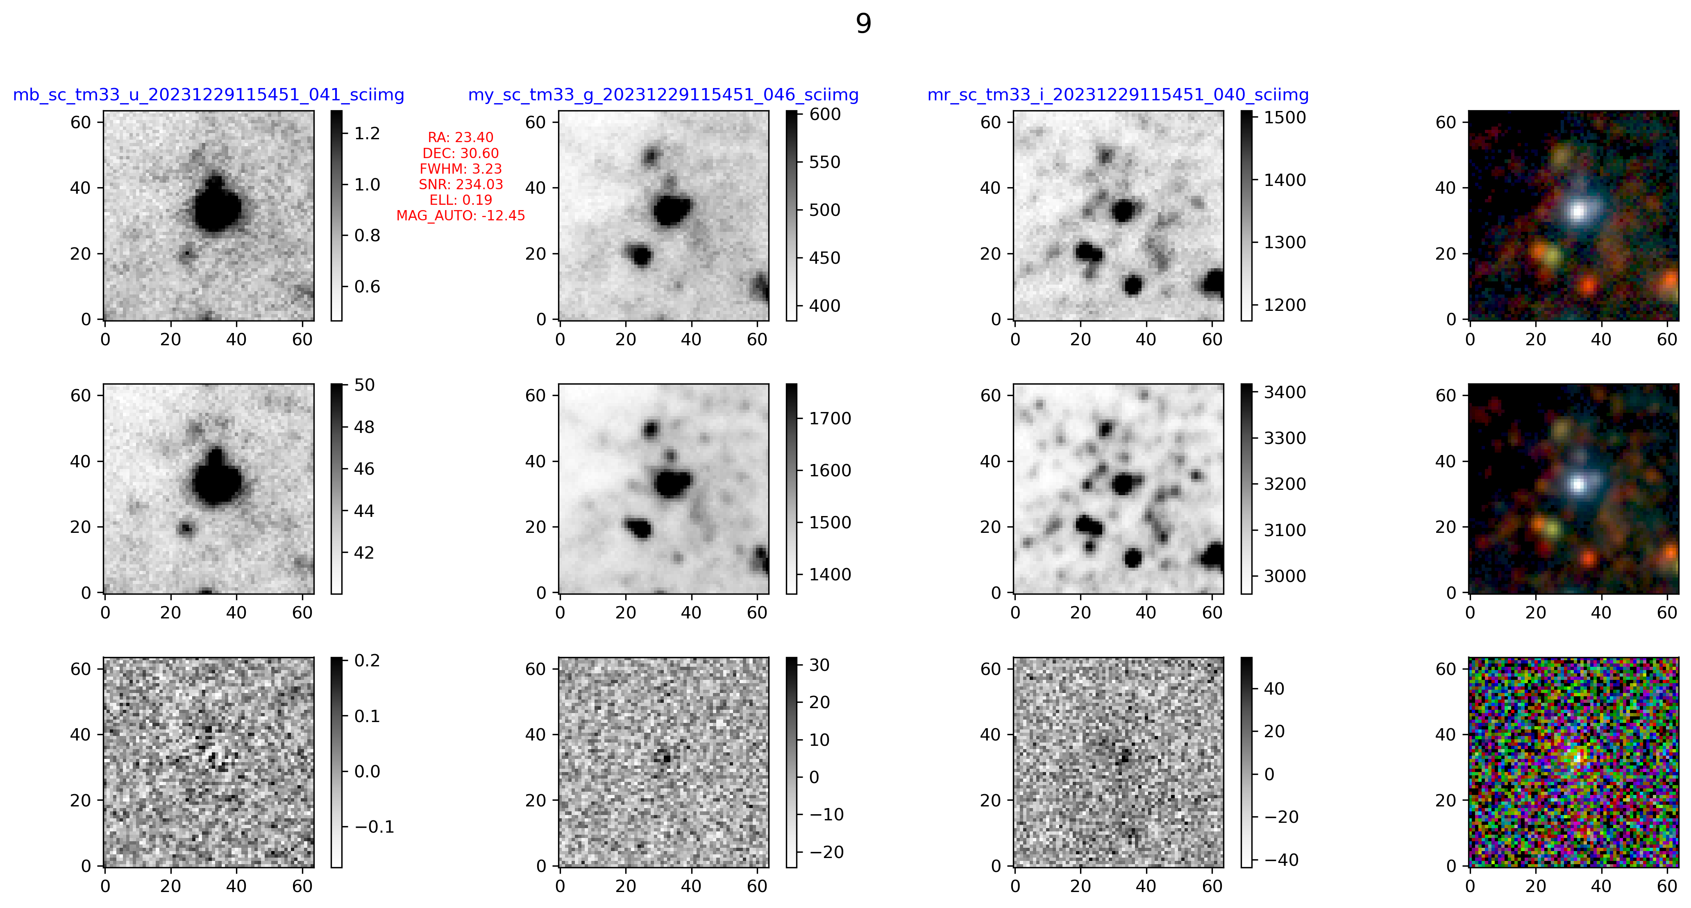
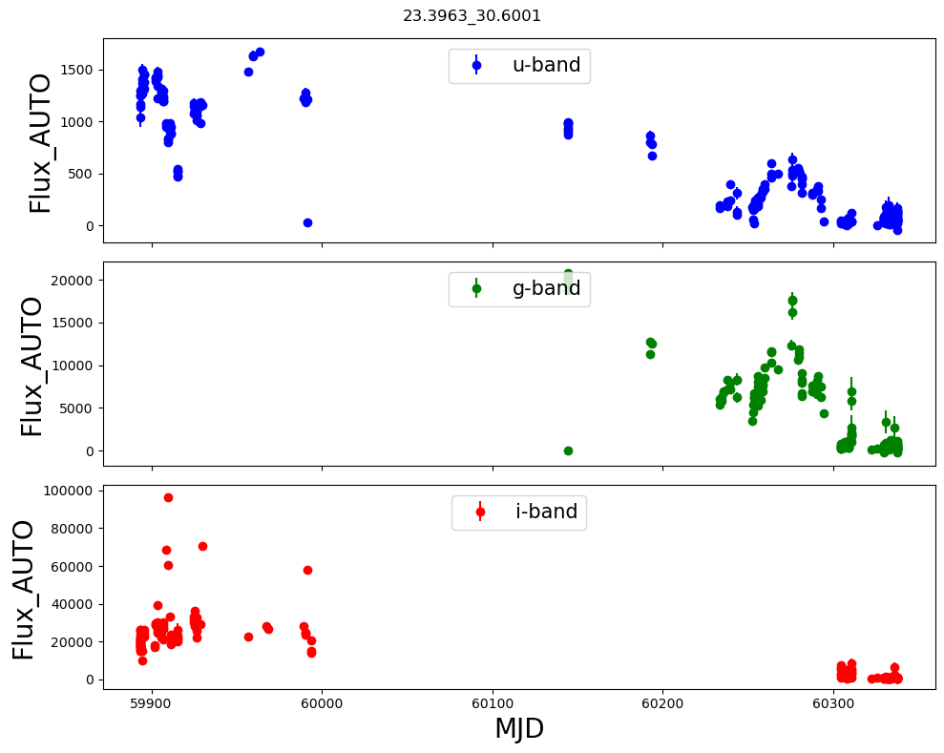
Result
Known Variables in M33
Lightcurves constructed via aperture photometry on the difference images.
Blue Supergiant
Sci
Ref
Diff
u g i RGB_image
Stamp : 64 pixels * 64 pixels
Notes:
这是m33中1个已知的蓝超巨星，这幅图从上到下分别是科学图像，参考图像，对减图像，从左到右依次是u波段、g波段、i波段图像，以及用三个波段合成的彩图，每个小图的大小是64像素*64像素。右边是在对减图像上做孔径测光得到的光变曲线。

Slide 11
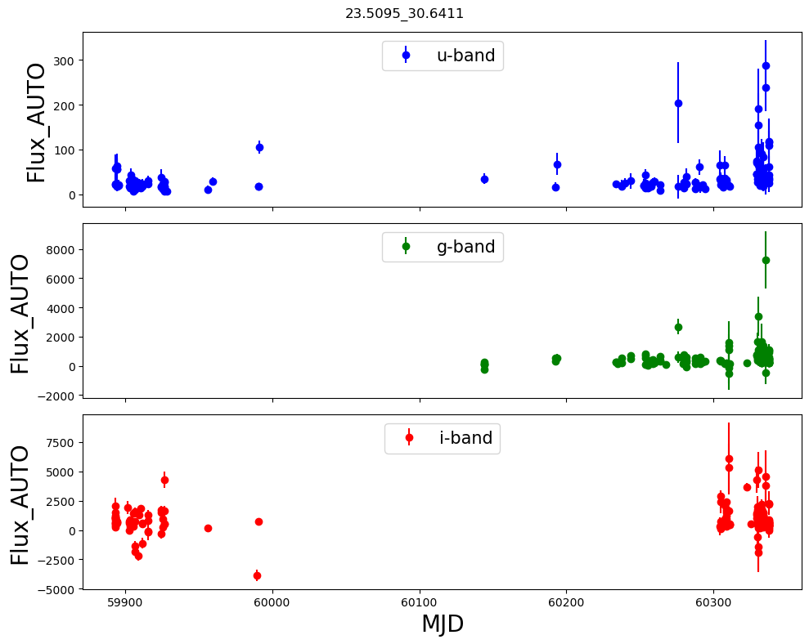
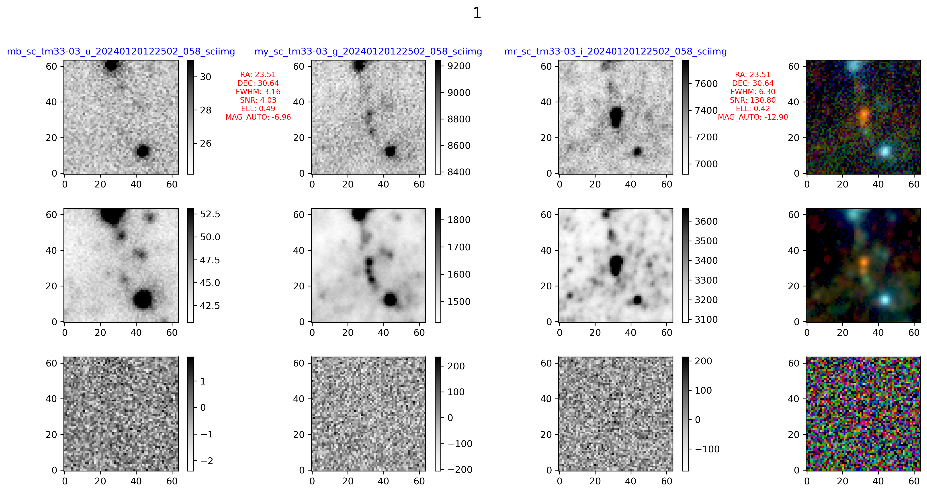
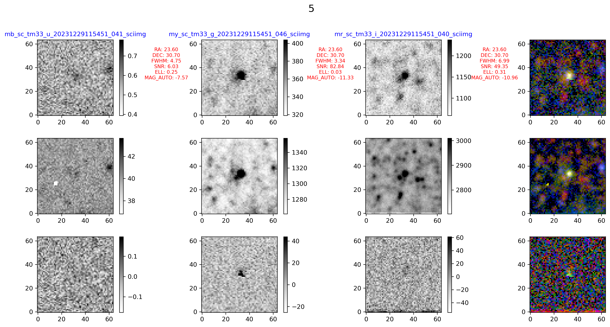
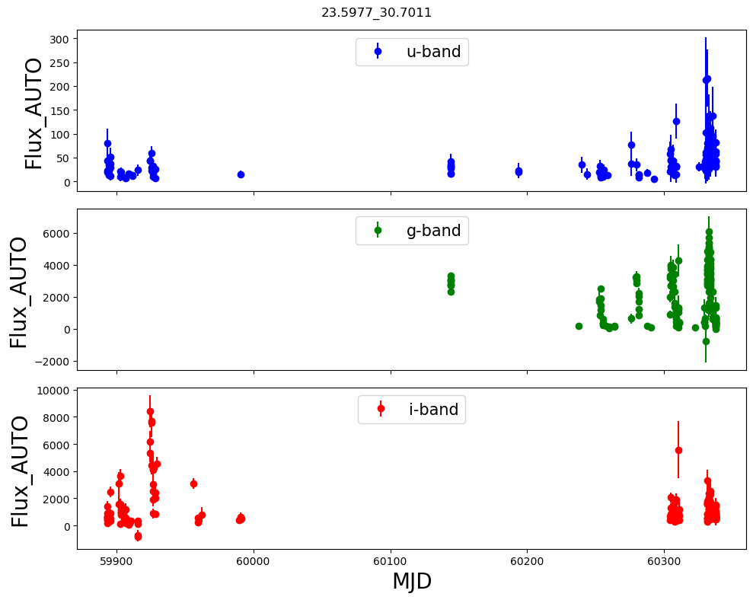
Result
Lightcurves constructed via aperture photometry on the difference images.
Red Supergiant
Sci
Ref
Diff
Cepheid
Sci
Ref
Diff

Slide 12
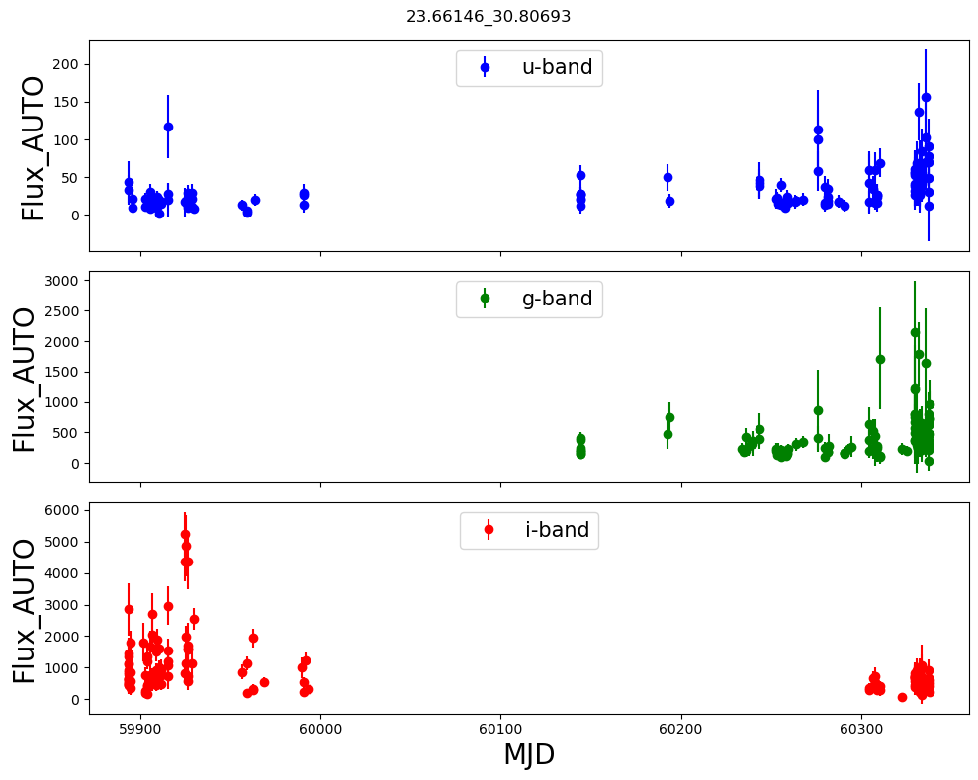
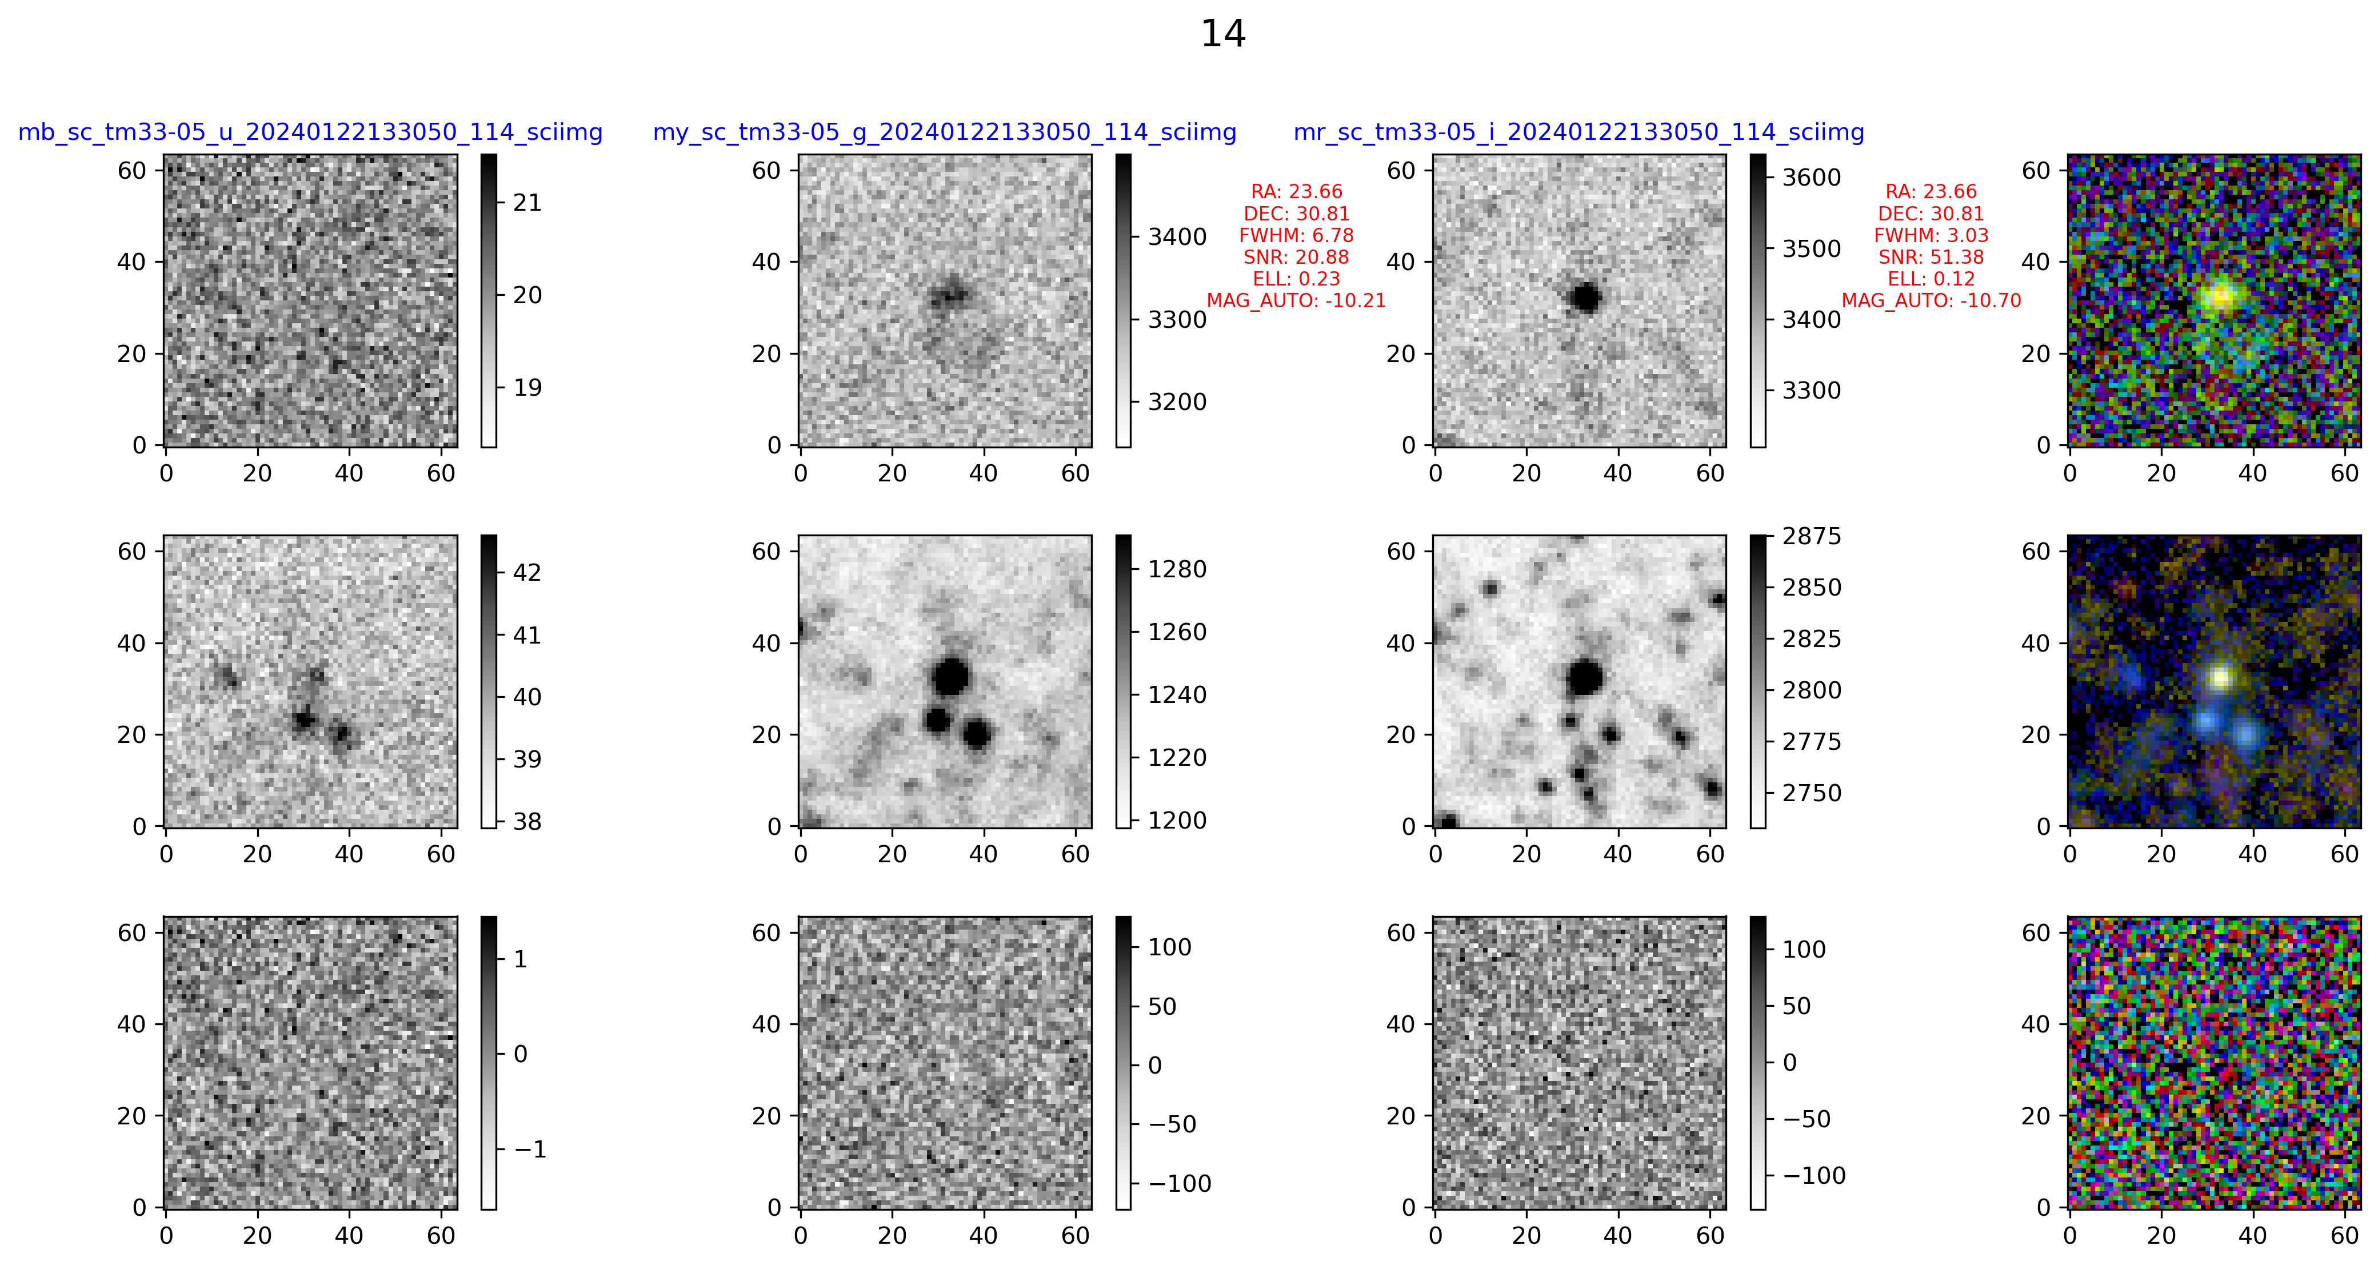
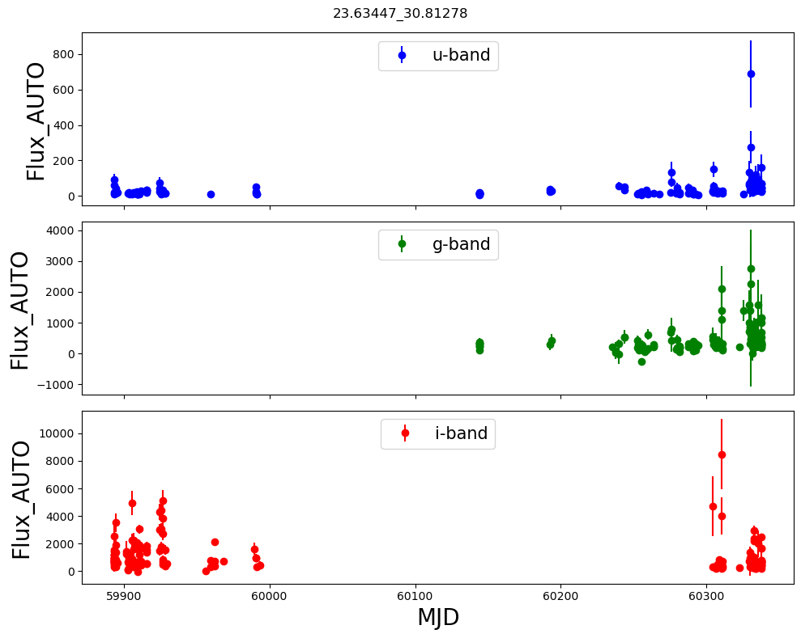
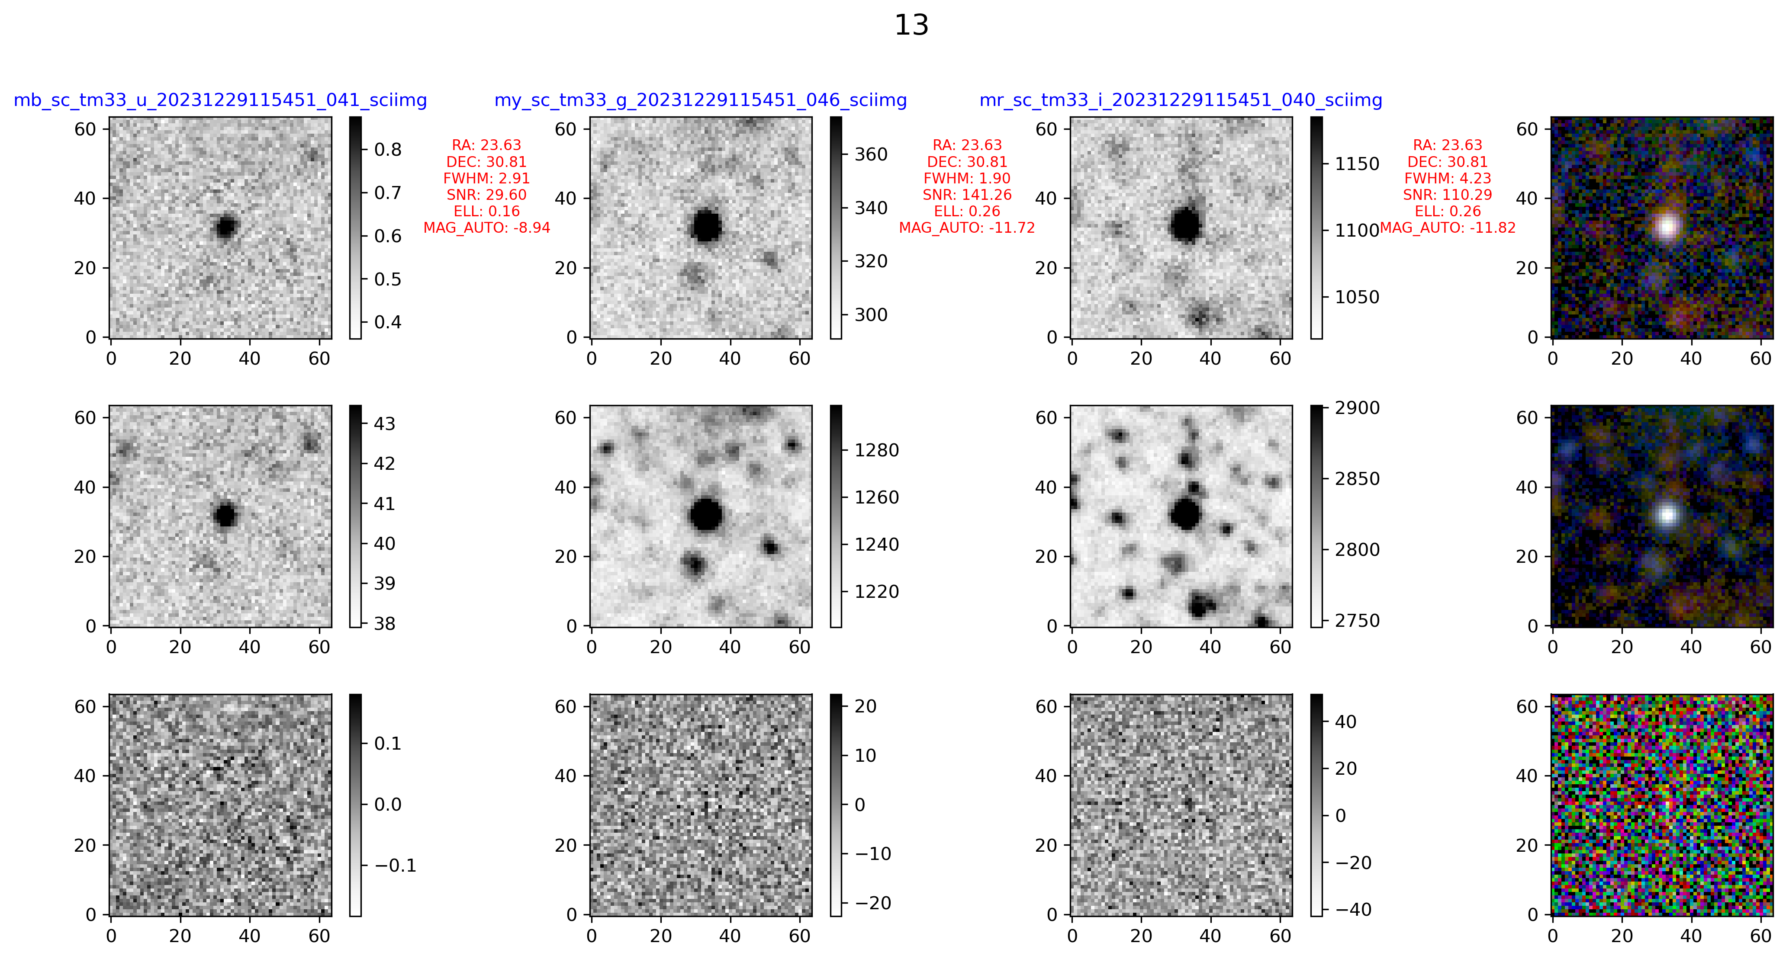
Result
Lightcurves constructed via aperture photometry on the difference images.
Variables candidate in M33
Sci
Ref
Diff
Sci
Ref
Diff
Notes:
这是m33中2个新的变源候选体，都能在红端看到有明显的残差。

Slide 13
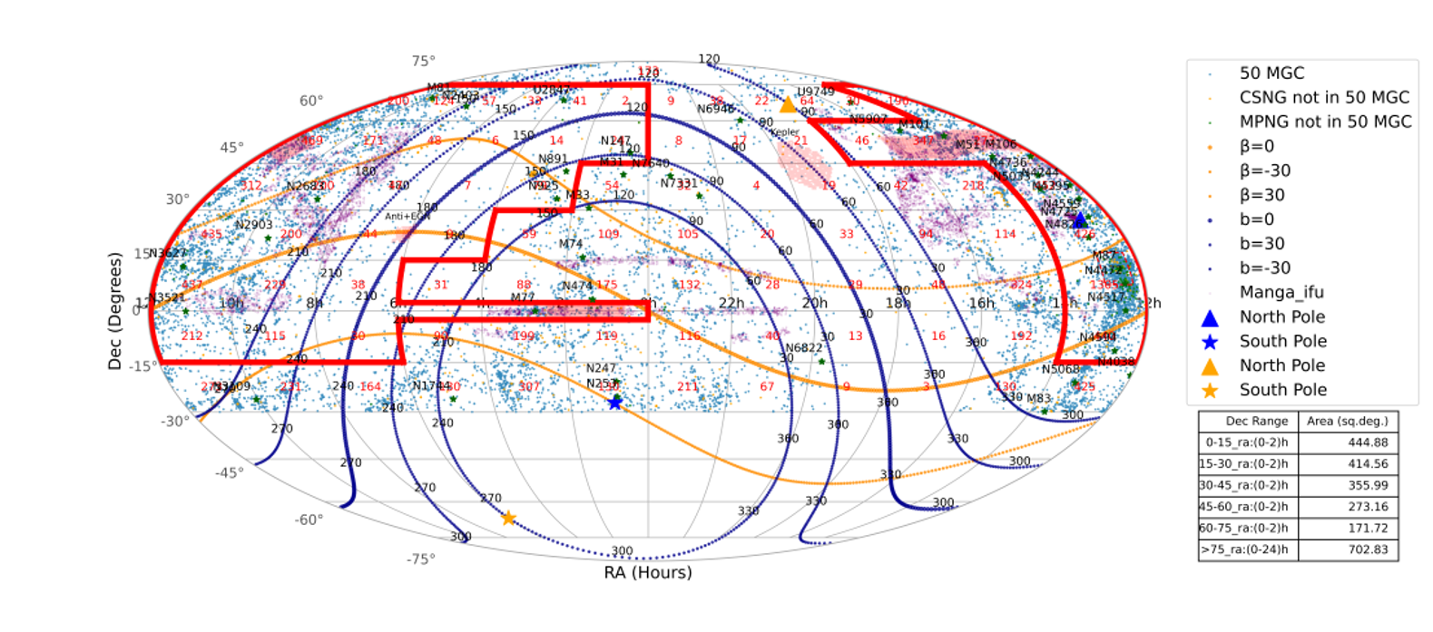
Summary and Outlook
Completed work
Conducted long-term, multi-band observation of M33.
Completed preliminary photometry and data analysis.
Create a Catalog of New Variable Source Candidates.
Future work
Classification of New Variables Candidates in M33.
Apply method to other nearby galaxies. (Such as M31, NGC4395)
Systematic Monitoring of Galaxies within 50 Mpc.
THANK YOU!

