Slide 1
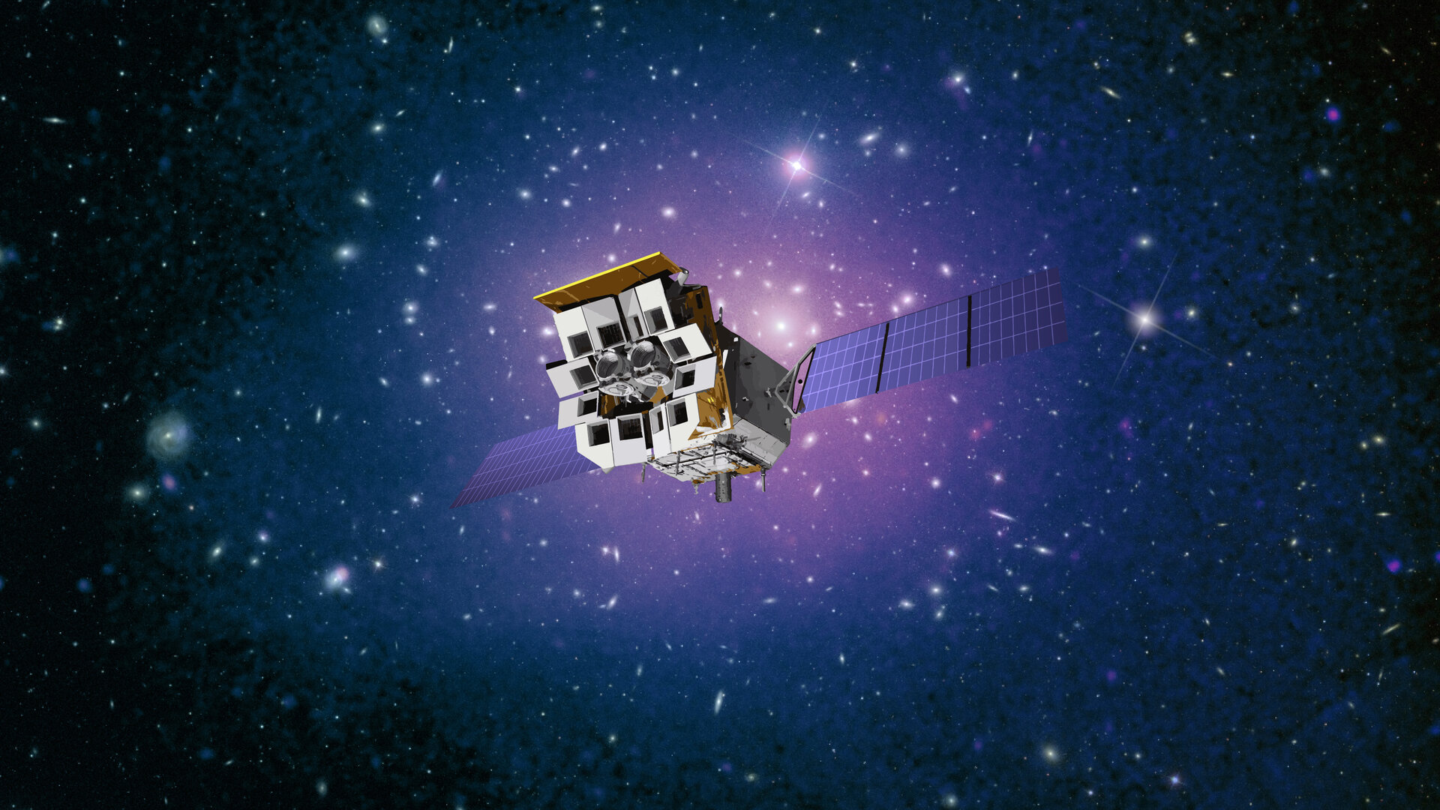



Status and scientific capability of the
Einstein Probe mission
张文达
国家天文台
on behalf of the Einstein Probe consortium
Image credit CAS/ESA
银河系及近邻星系时域研讨会，丽江，3-7/8/2024

Slide 2
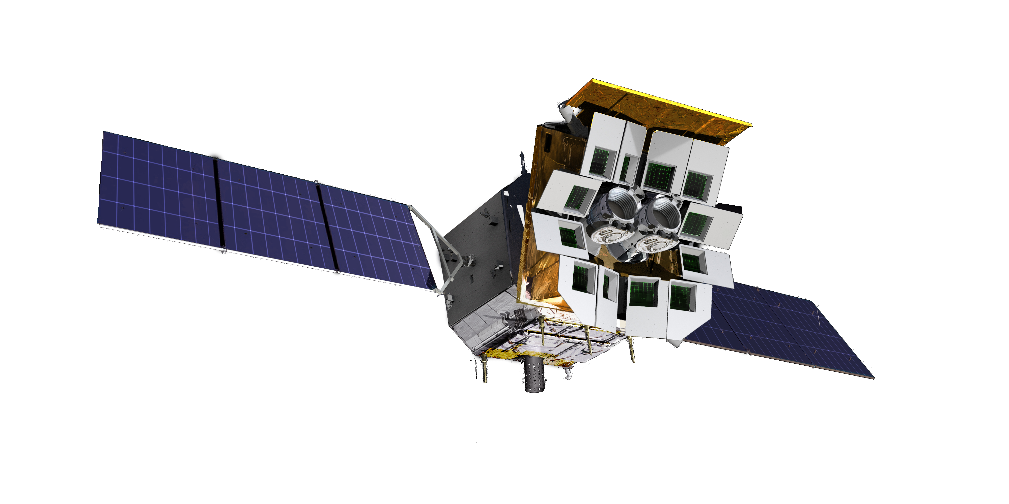

Einstein Probe (EP) mission
Goals a time-domain astro. mission
Discover soft X-ray transients & monitor source variability with improved sensitivity
Characterise transients/variables by quick X-ray follow-up onboard
Disseminate transient alerts to astro. community in time
Milestones
2010- Lobster-eye R&D @ XIL/NAO (est. by S.-N. Zhang)
2012 Mission concept
2017/12 Adoption
2018 Joined by ESA & MPE; 2022 CNES
2022/07 Pathfinder LEIA launched
2024 Jan. 9 launch
2024/07 nominal mission (lifetime: 3 yr, goal 5 yr)

Slide 3
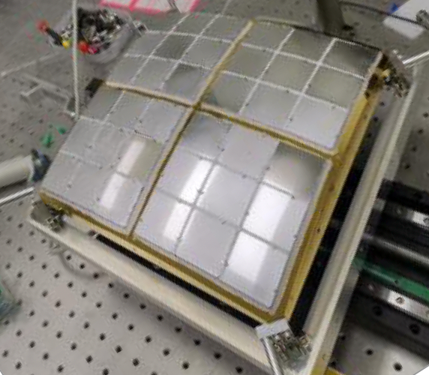
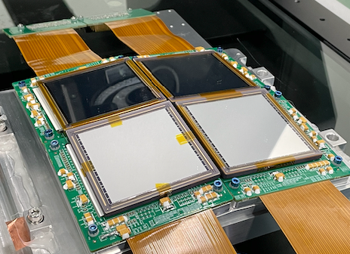

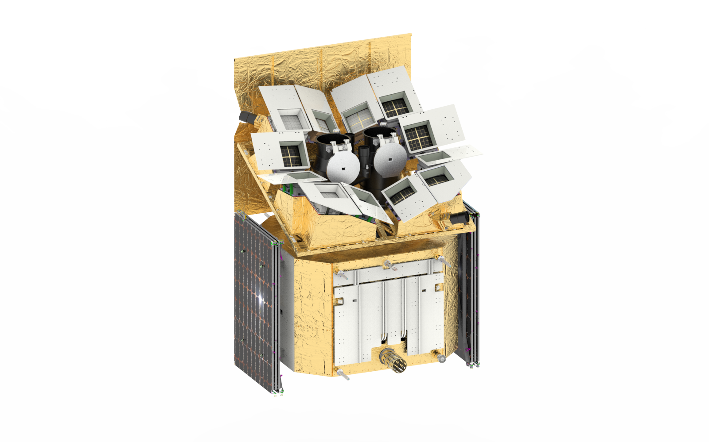

Instruments & spacecraft
Wide-field X-ray Telescope
WXT (12 modules)
Lobster-eye MPO + CMOS
FoV: ~3,600 sq deg (1.1 sr)
Band: 0.5 – 4 keV
Resolution: ~ 5’ (FWHM)
Sensitivity: ~1mCrab @1ks
WXT mirror & CMOS detectors (1 module)
Spacecraft
On-board data processing
Quick slew & autonomous follow-up
Follow-up X-ray Telescope
FXT (2 units)
Wolter-1 + pn-CCD (eROSITA)
FoV: ~1 deg
Band: 0.3 -10keV
Resolution: 24” (HPD, on-axis)
Effe. area: ~300 cm² @1keV (x 2 units)
Telemetry
X/S-band (several hours)
BD (down/up-link; minutes)
VHF (down-link; minutes)
Yuan, et al. 2022 Handbook of X-ray and Gamma-ray Astrophysics

Slide 4
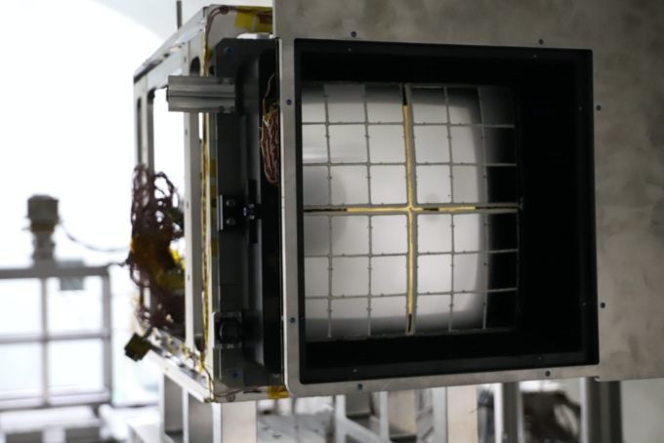
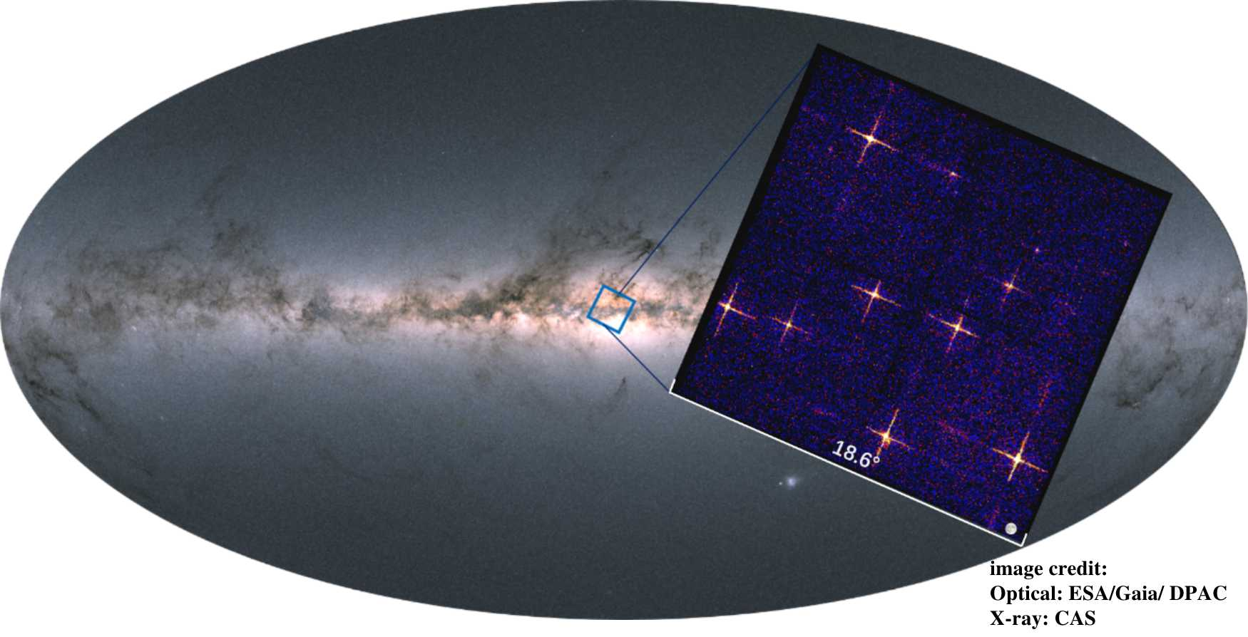
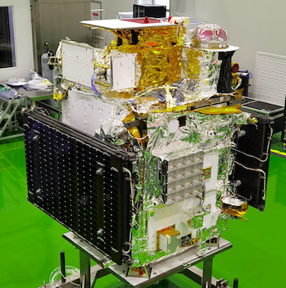
EP-WXT pathfinder LEIA (Lobster Eye Imager for Astronomy)
Instrument test observations
August 8-10, 2022
~800s exposure
FoV 340 deg²
LEIA 0.5 – 4 keV
Size of full Moon
Lobster-eye & CMOS technology verified
CAS’s SATech-01 experiment satellite
Launched 2022-07-27
credit: MicroSAT
Frist wide FoV X-ray observations by a lobster-eye focusing X-ray telescope in orbit Zhang et al. 2022 ApJL, 941, L2

Slide 5
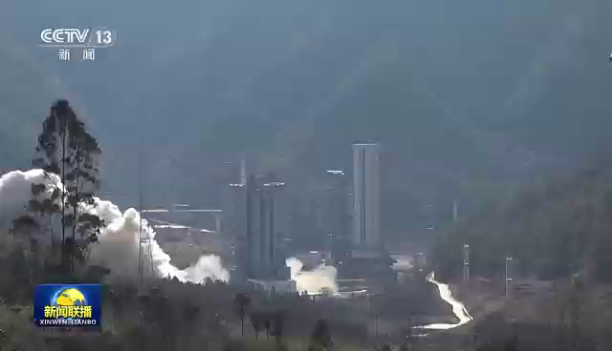
Launch of EP Jan. 9, 2024
Launch of EP Jan. 9, 2024
  height 592 km
  orbital period 96min
  inclination angle 29 deg.
  height 592 km
  orbital period 96min
  inclination angle 29 deg.
LM-2C @Xichang

Slide 6
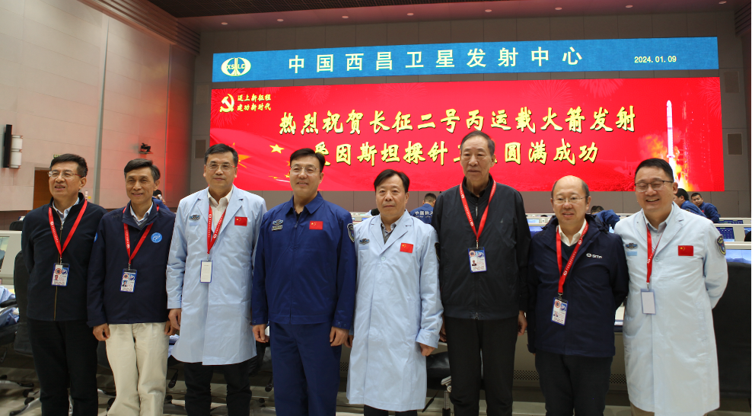
Launch of EP Jan. 9, 2024
  height 592 km
  orbital period 96min
  inclination angle 29 deg.

Slide 7
Commissioning phase just completed
Payloads & SC: In-orbit tests, verifications and calibration just almost completed and passed review
  Spacecraft and payloads
  Satellite-ground interface & workflow（S/X-band, VHF, BD short-message system)
Onboard transient search, triggering, and automated FXT follow-up obs. achieved
Spacecraft & instruments working normally
  some minor anomalies are being resolved/improved
In-orbit/on-ground calibration results agree
Start of science operations: July 10 (nominal: end of July)

Slide 8
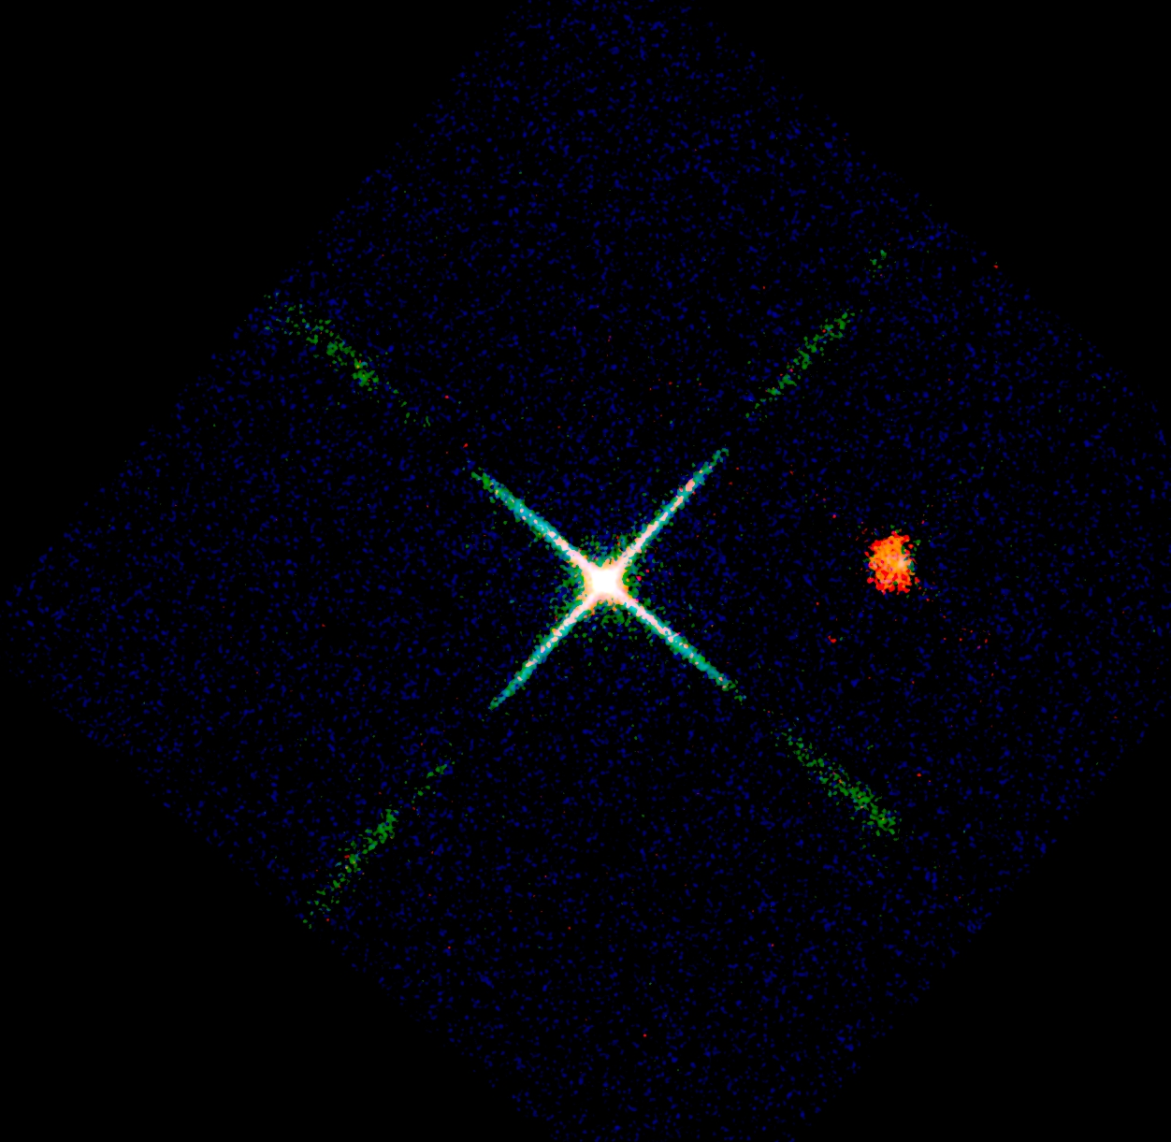
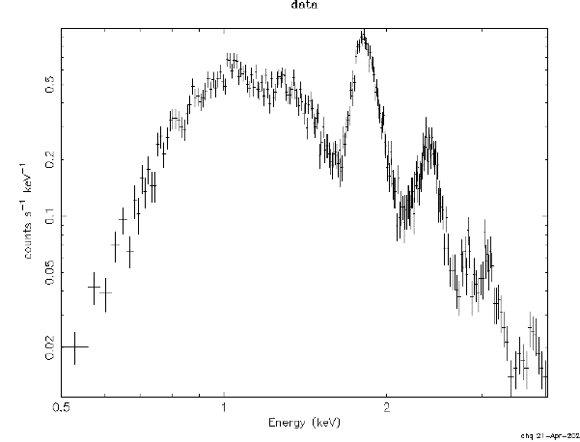

X-ray First light 2024 Feb. 19
Cassiopeia A supernova remnant (nebula)
X-ray spectrum obtained at the same time
Si He 1.83
S He 2.41
Counts/sec/keV
$Δ$E ~ 122eV @1.25keV
Energy (keV)
Red: 450 to 1000 eV
Green: 1000 to 2000 eV
Blue: 2000 to 5000 eV
Image size 9.3° X 9.3 °
exposure 22 kilo-seconds
X-ray data credit: EPSC, image credit: Chen Zhang, Huaqing Cheng.

Slide 9
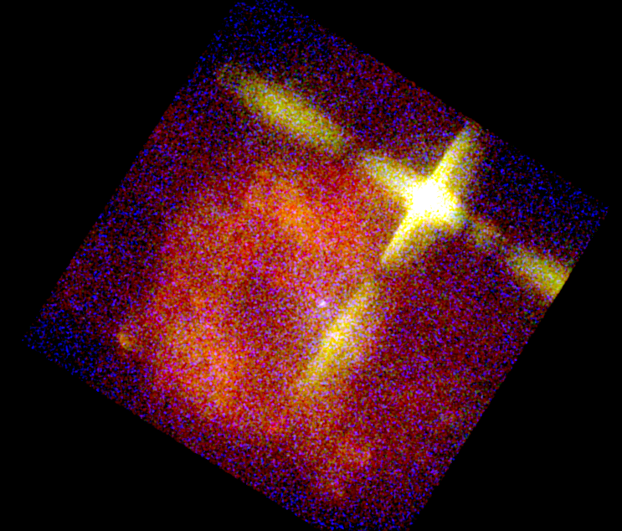
9.3° by 9.3 °
Vela supernova remnant X-ray (nebula)
exposure 9.3 kilo-seconds
mage size 9.3° X 9.3 °
Vela supernova exploded about 11000 yr ago
936 light years to Earth
Red: 400 to 800 eV
Green: 800 to 1500 eV
Blue: 1500 to 5000 eV
X-ray data credit: EPSC, image credit: Chen Zhang, Huaqing Cheng.

Slide 10
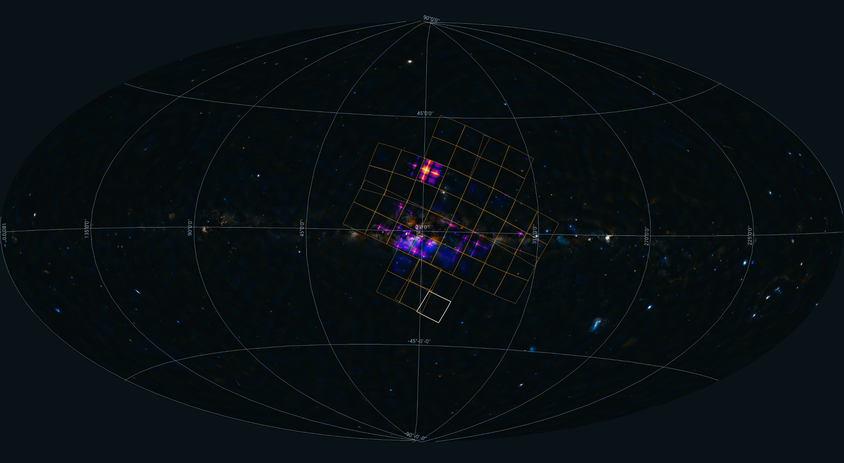
Central region of our Galaxy
WXT covers 1/11 area of the entire sky in one snapshot
X-ray data credit: EPSC, image credit: Chen Zhang, Huaqing Cheng.

Slide 11
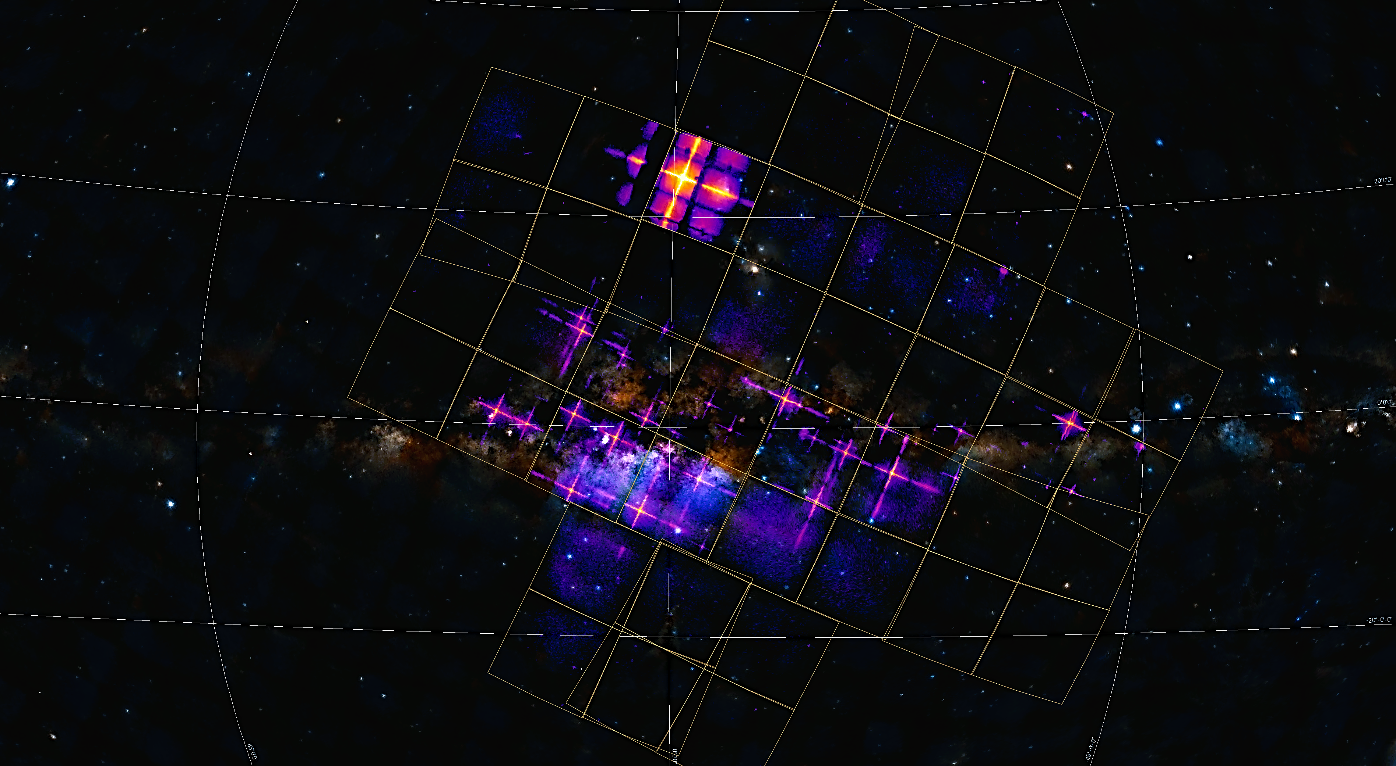
Central region of our Galaxy (purple, red, yellow)
9.3°
WXT FoV 3850 sq. deg.
2
exposure 40 kilo-seconds
9
3
6
4
1: Cir x-1 and Swift J151857.0-572147
2: Sco X-1
3: V2216 Oph
4: V1101 Sco
5: V821 Ara
6: NP Ser
7: V4134 Sgr
8: Sgr X-4
9: Lupus SN
10: SNR RCW 86
1
10
7
5
8
X-ray data credit: EPSC, image credit: Chen Zhang, Huaqing Cheng.

Slide 12
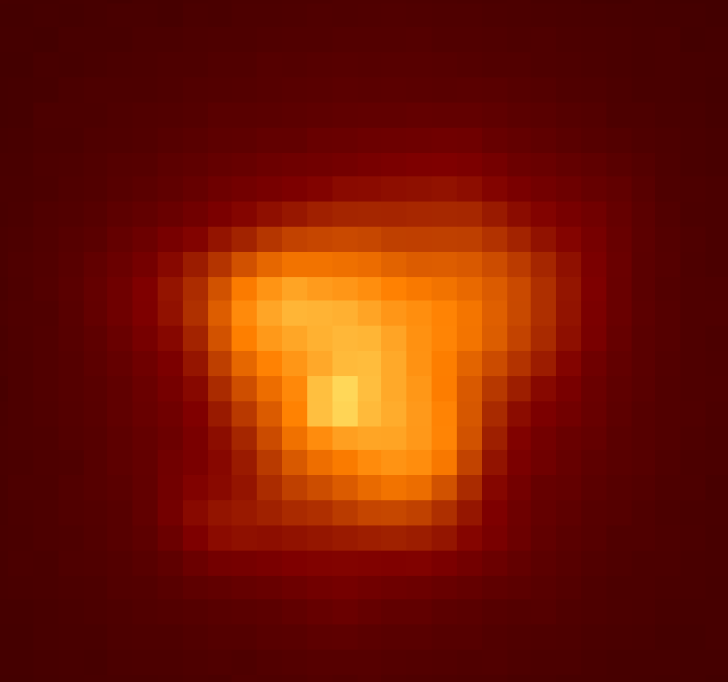
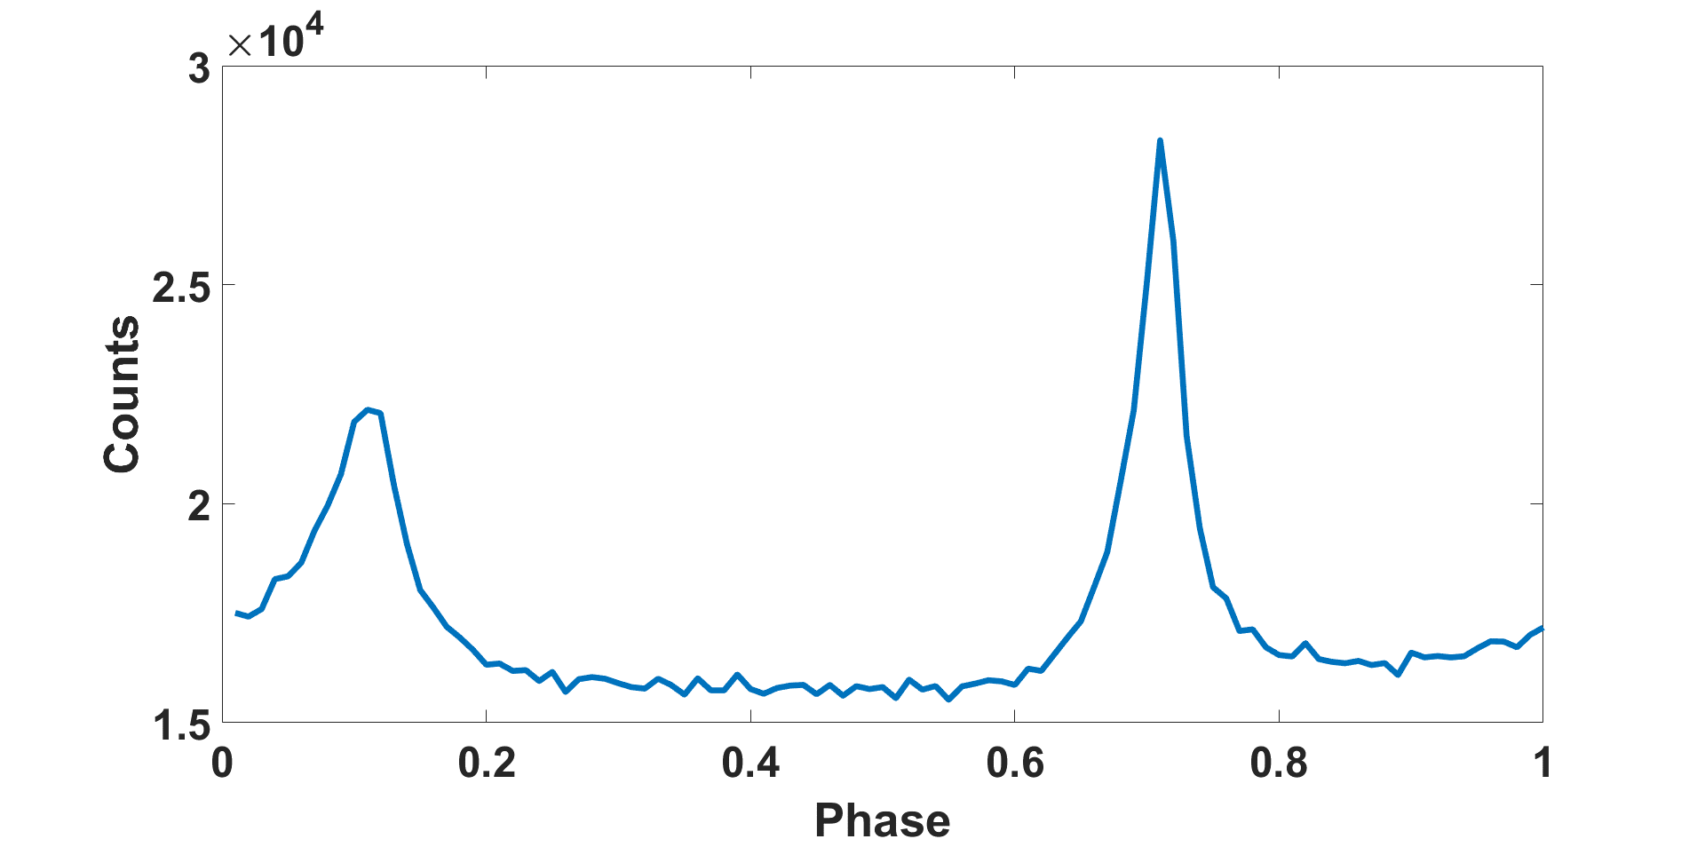
FXT X-ray First light
Crab nebula supernova remnant
Band 0.3-10 keV
Exposure 2600s
Crab pulsar spin period 33.98 ms
timing mode: time resolution 42 micro-sec

Slide 13
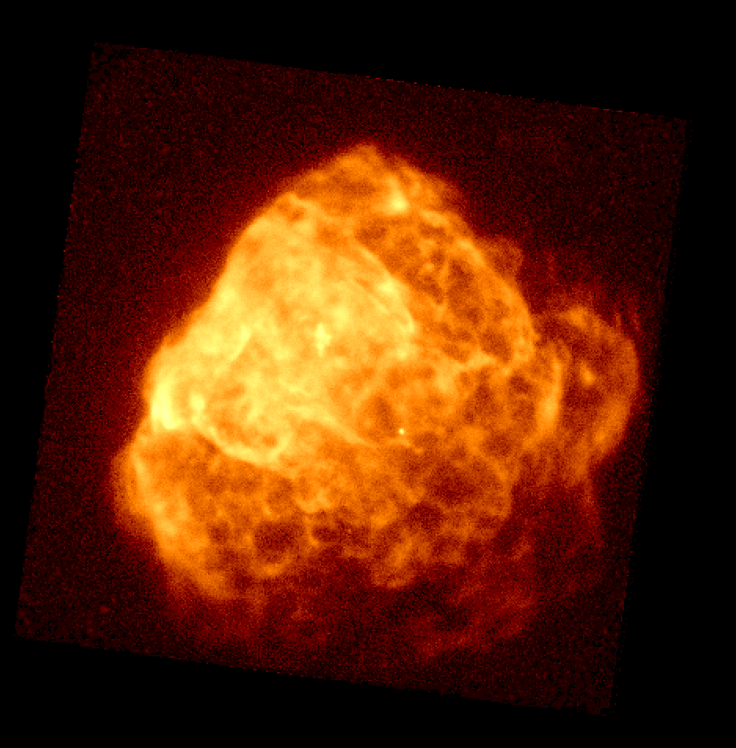
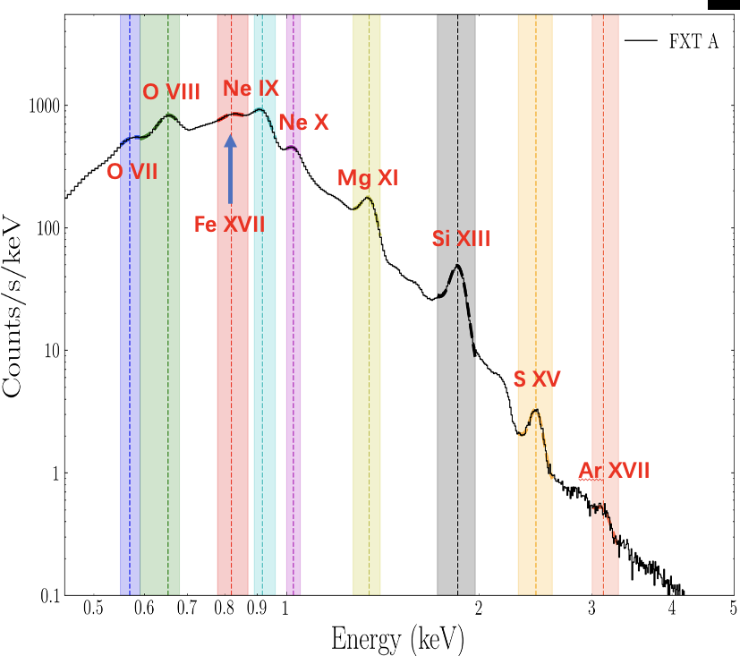
FXT X-ray First light (0.3-10 keV)
Puppis A supernova remnant (nebula)
FoV 1 deg
FXT X-ray spectrum obtained at the same time

Slide 14
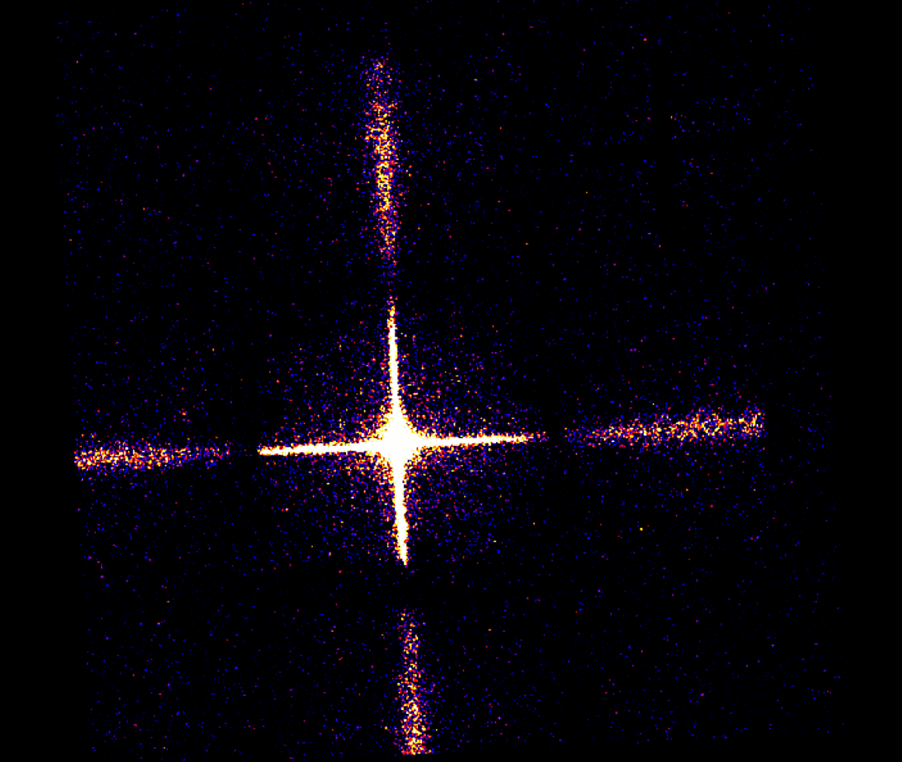
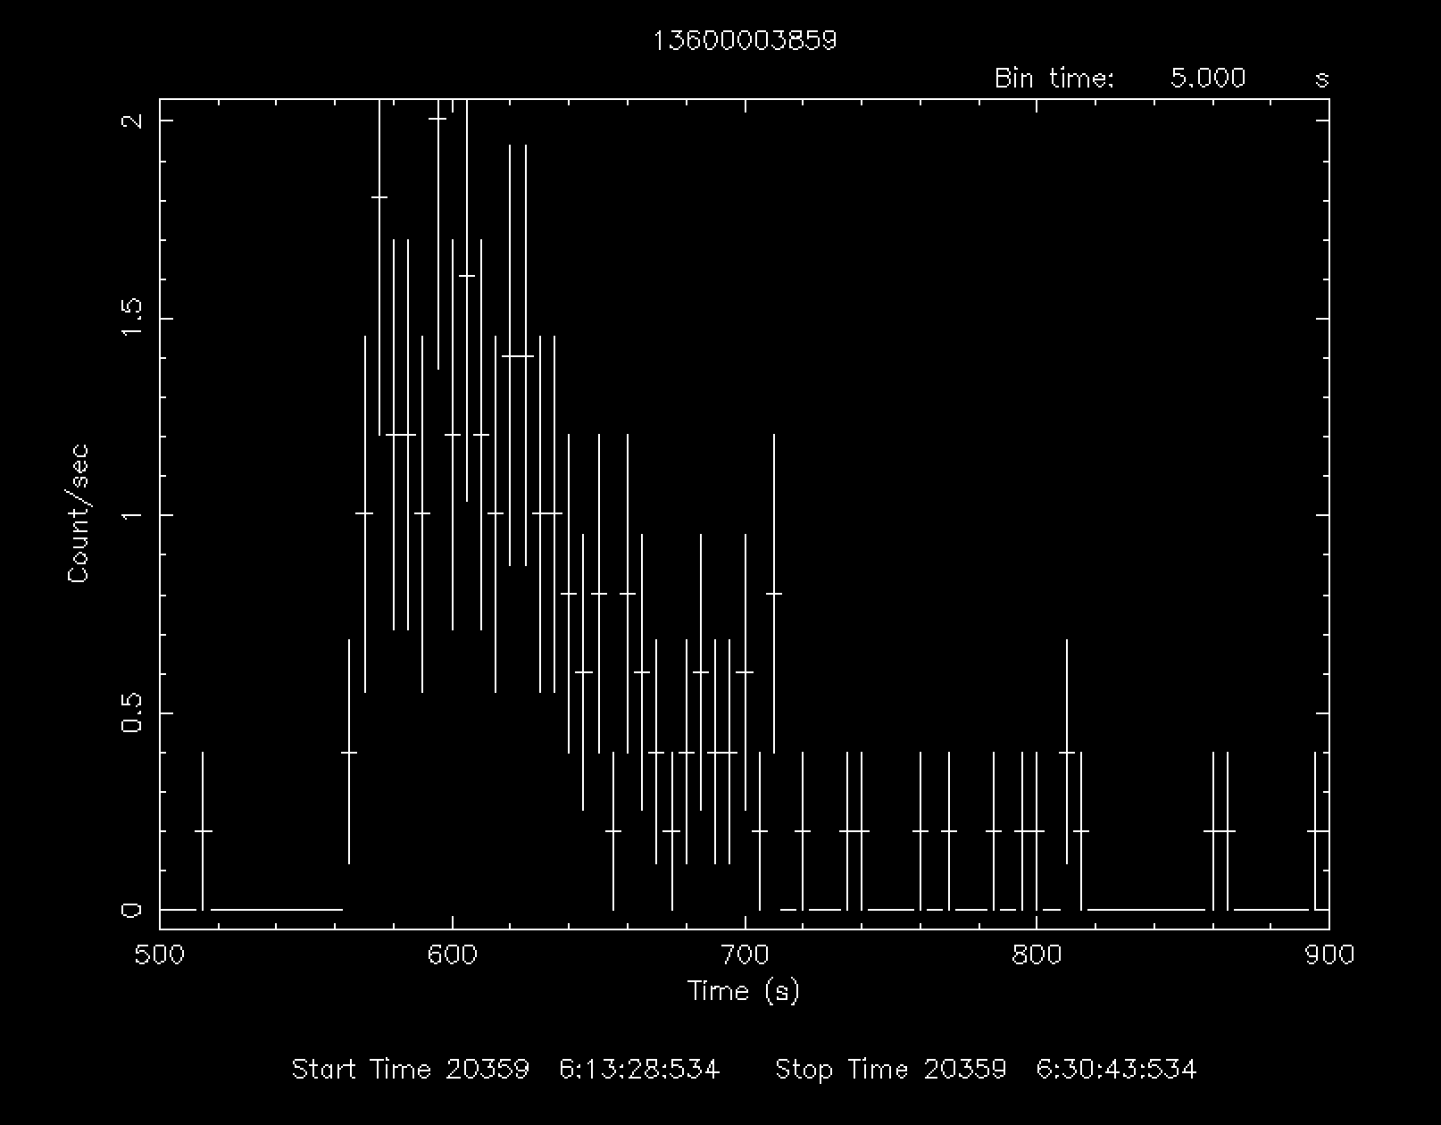
EP240219a
The first X-ray transient discovered by WXT on Feb 19, 2024, alert released on Astronomer's Telegram
Duration < 200s
Subthreshold GRB signal found in Fermi/GBM data (Zhang ATel #16473)
Undetected by Swift/XRT 39 hours later
Atel sent from EPSC: 1st EP alert!
No optical counterpart found （starting T0+3days）
Possibly an X-ray rich GRB
WXT 主任设计师 （上海技物所）
9.3° by 9.3 °, 1 time-frame = 33.3 sec
Yin et al. ApJL submitted

Slide 15
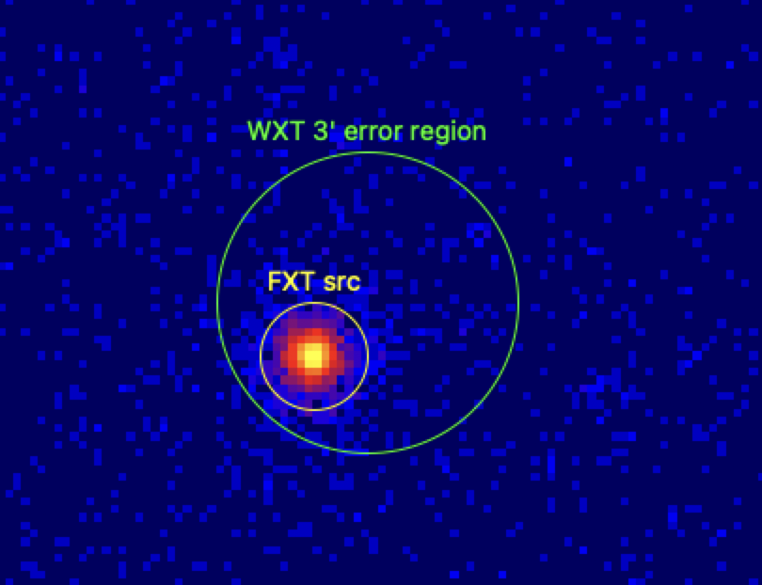
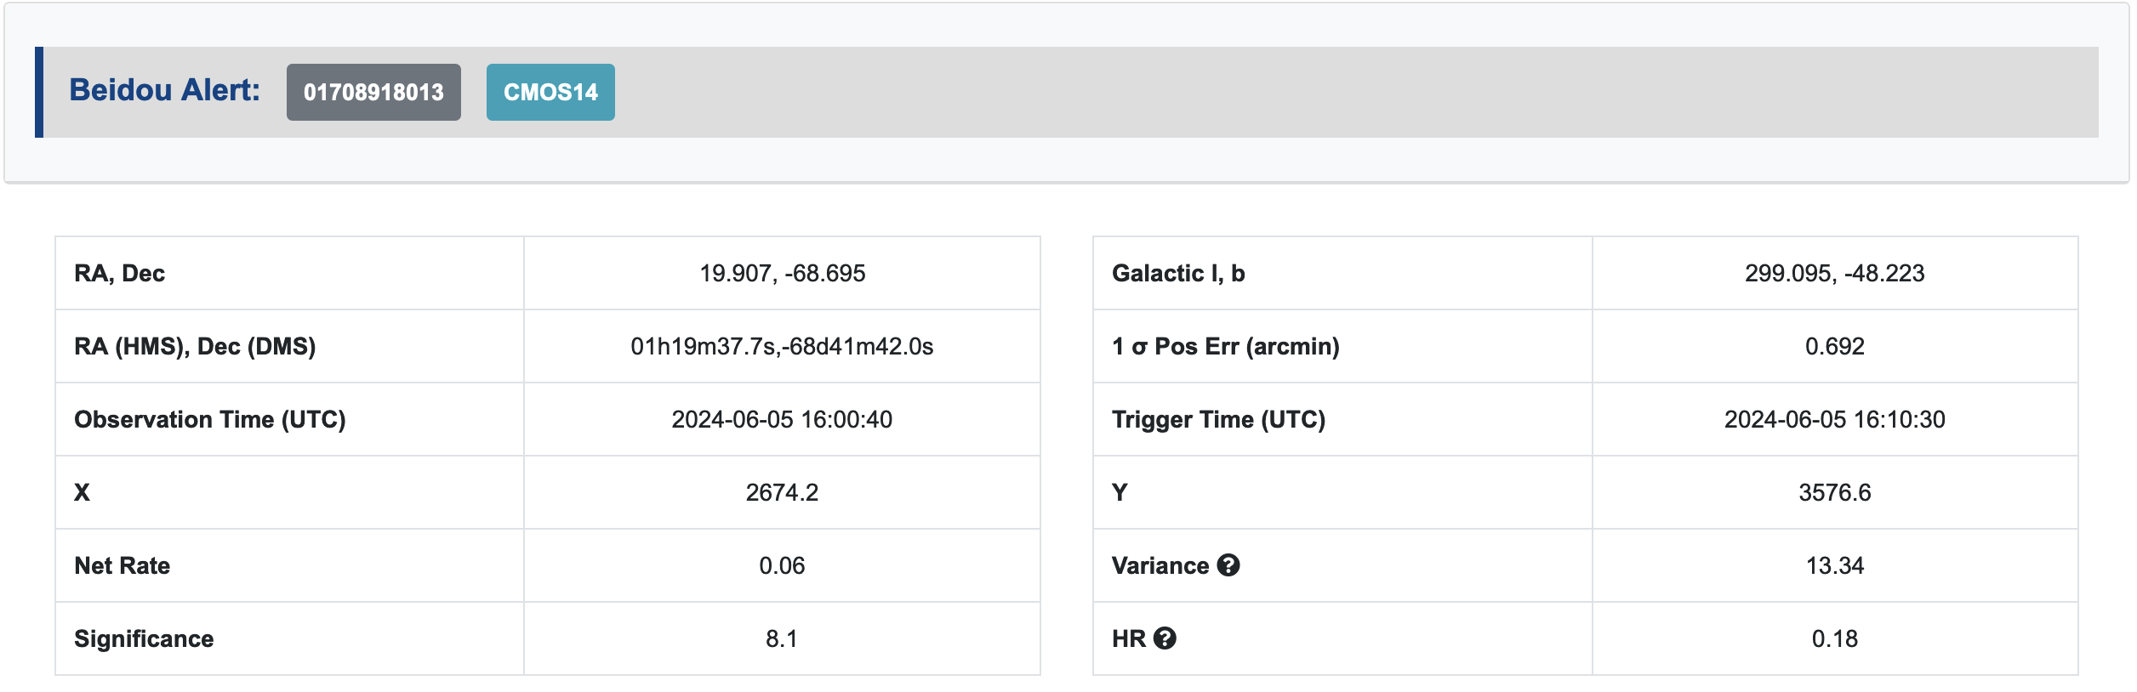
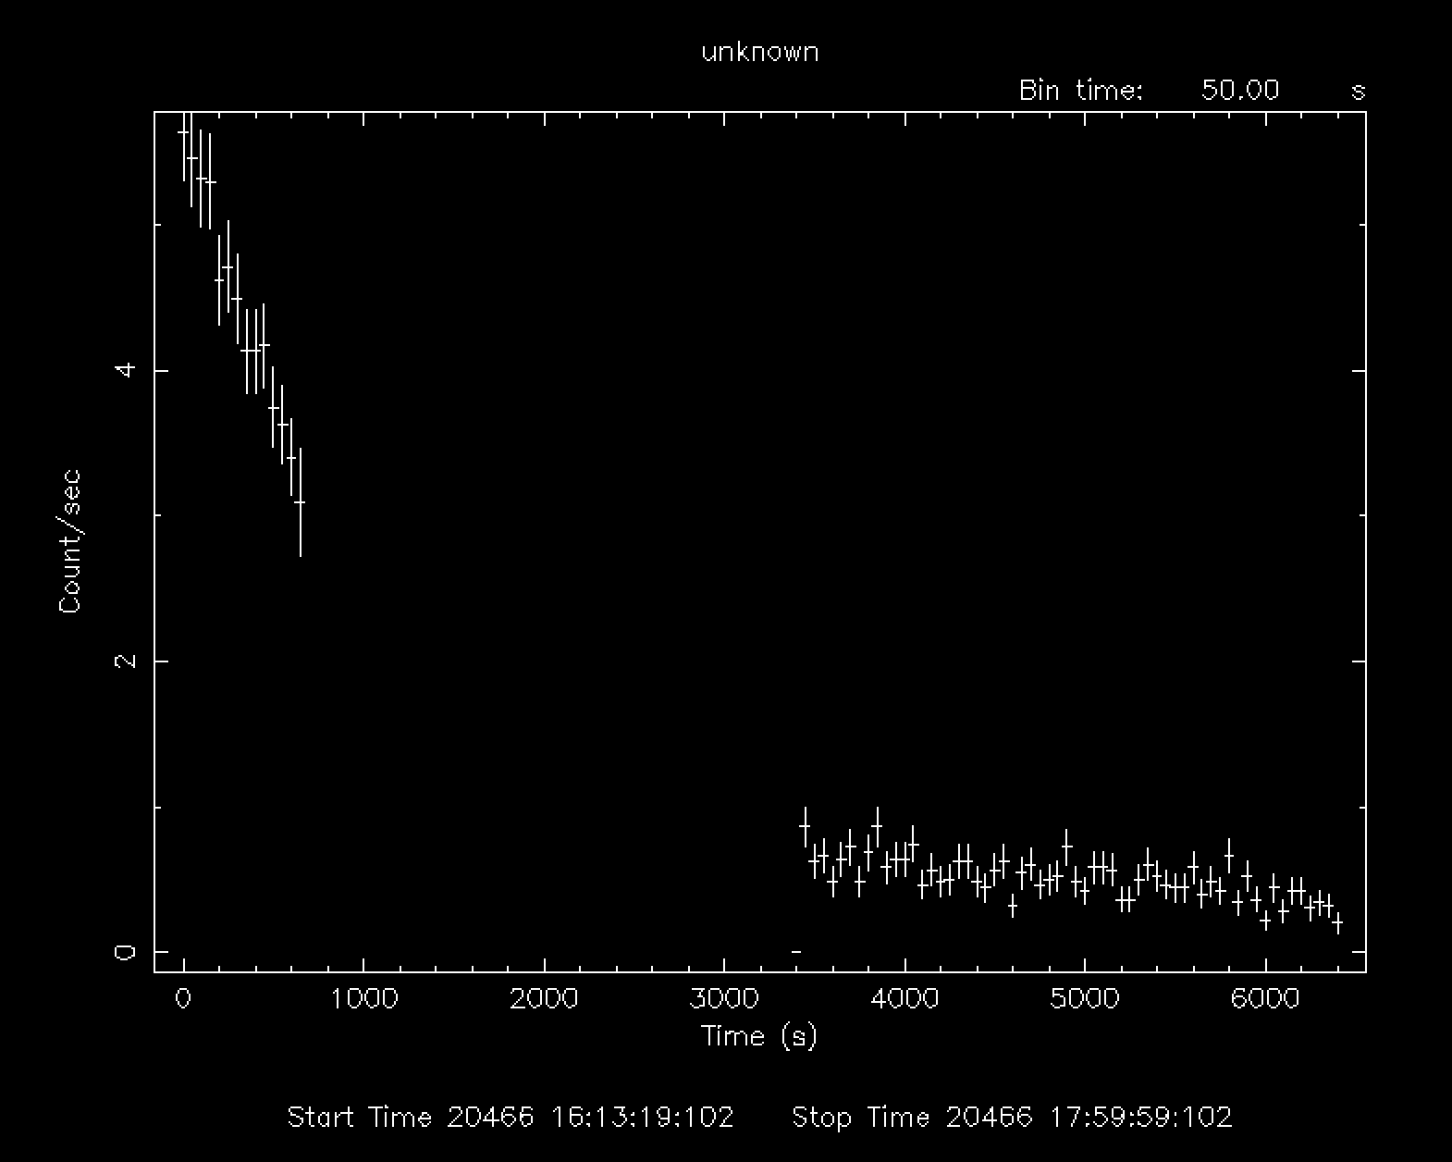
Onboard trigger for FXT automated follow-up
1st successful test: EP240605a June 5 UTC 16:10:30,
transient info downlink within minutes (BD & VHF)
triggered FXT obs @ UTC 16:11:44
  1 min after triggering
FXT X-ray image
expo 3.6 ks
alert information downlinked via BD
FXT error < 10arcsec
FXT X-ray lightcurve
flare star (FXT spec)

Slide 16
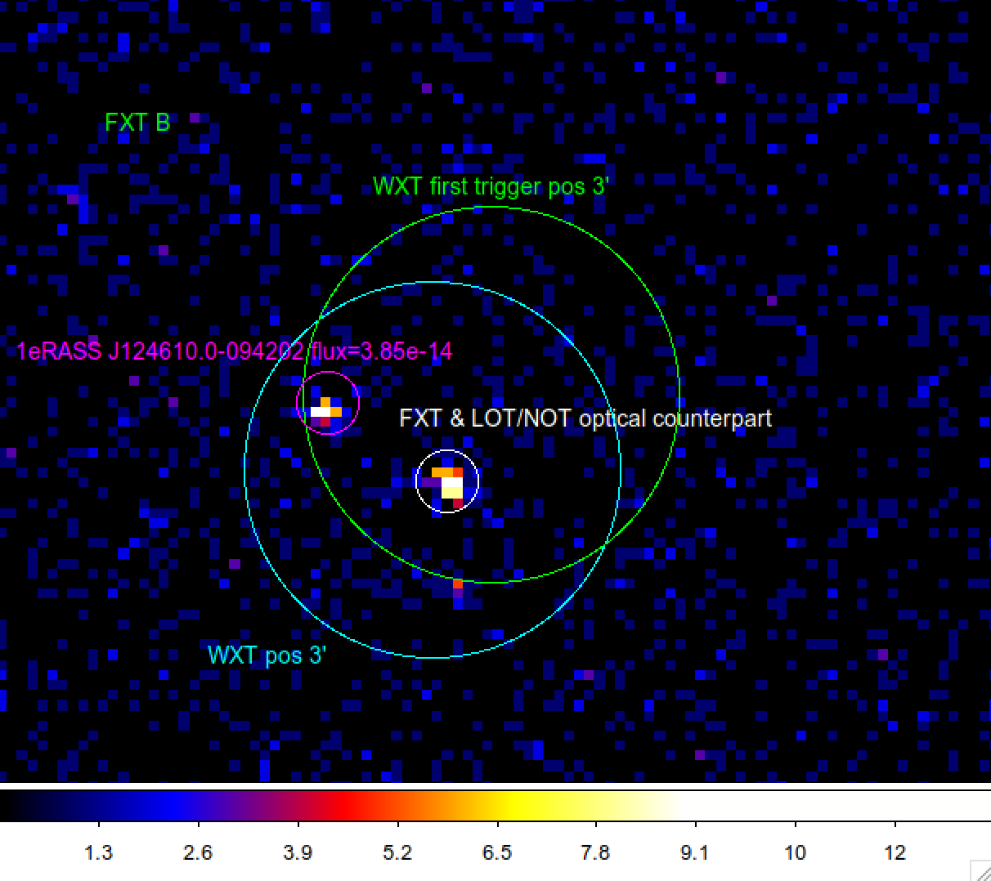
EP240414a: the quickest follow-ups
WXT onboard trigger (VHF/BD)
  (Lian et al. GCN 36091)
T0+ 2hrs: FXT follow-up (uplink ToO)
  A new source 1.5’away
Optical follow-up
  LOT + 3.13 hr (AT2024gsa, r= 21.52 mag)
  NOT +2.29 hr
  GTC +5 hr
  BOOTES-4/MET +5.56 hr
  Pan-STARRS1 +2/3 d
  GSP + 3.66 d
Later time detection of associated supernova (Levan et al. GCN 36355)
Host galaxy z = 0.41
Projected offset ~25 kpc (Jonker et al. GCN 36110)
FXT image expo 7.2 ks
90% positioning errors
WXT: 2.1 arcmin
FXT: < 10 arcsec

Slide 17
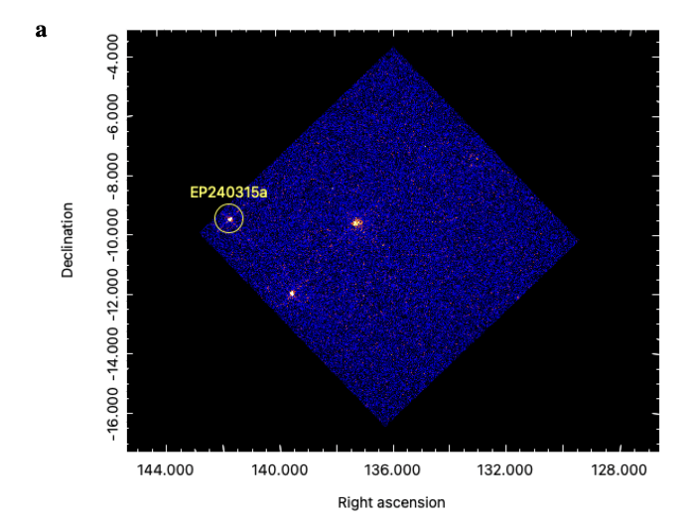
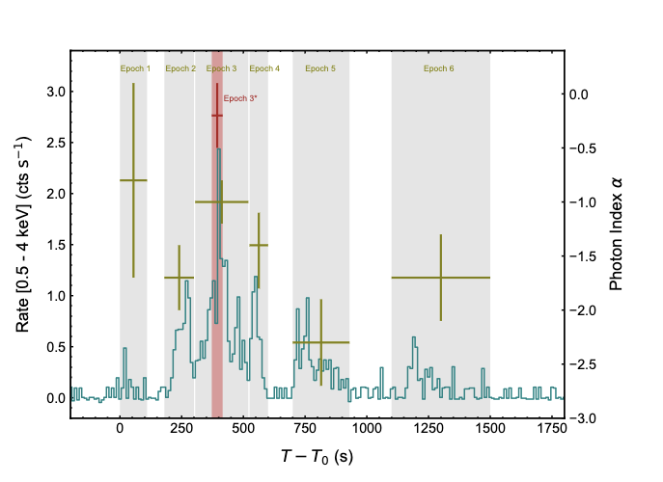
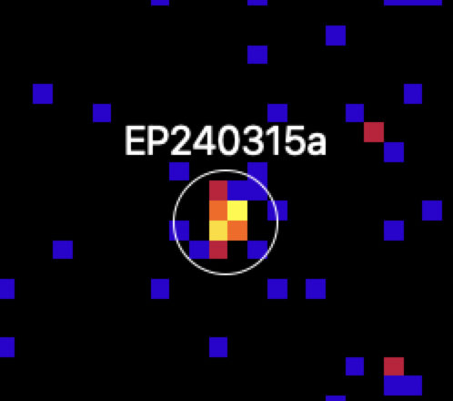
EP240315a: GRB @redshift 4.859
WXT image
Soft X-ray T90: 1000 s
Gamma-ray T90：<50 s
by Swift/BAT & Konus-Wind
FXT detection of X-ray afterglow
Onboard trigger, confirmed by on-ground analysis
Marked difference in LC of soft X-ray and hard X/γ rays
Gillanders J.H., et al. arXiv:2404.10660 (ATLAS optical/radio counterpart, z)
Levan A., et al. arXiv.2404.16350 (Stargate optical pho. and spec., z)
Liu Y., et al. arXiv:2404.16425 (jointly with Swift, Konus-Wind, Stargate teams)
redshift 4.859 measured by VLT (Levan et al. 2024)
detectable by WXT at z~7.5
EP’s potential of detecting high-z GRB !

Slide 18
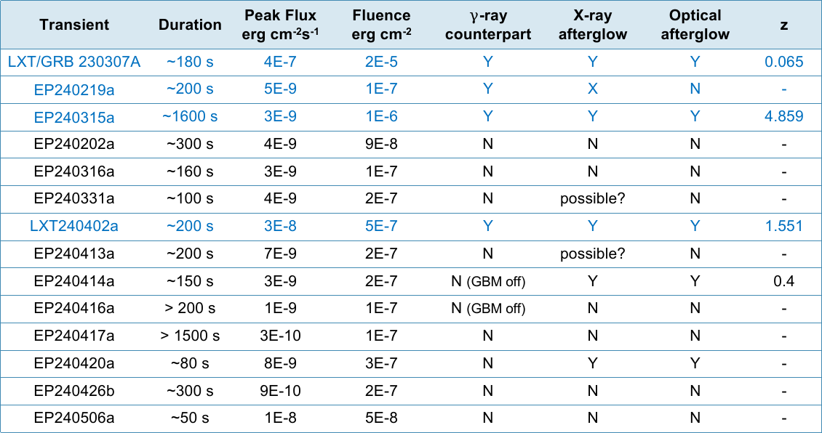
GRBs(4)/Fast X-ray transients (10) by EP & LEIA
Transient | Duration | Peak Flux erg cm⁻²s⁻¹ | Fluence erg cm⁻² | $γ$-ray counterpart | X-ray afterglow | Optical afterglow | z
LXT/GRB 230307A | ~180 s | 4E-7 | 2E-5 | Y | Y | Y | 0.065
EP240219a | ~200 s | 5E-9 | 1E-7 | Y | X | N | -
EP240315a | ~1600 s | 3E-9 | 1E-6 | Y | Y | Y | 4.859
EP240202a | ~300 s | 4E-9 | 9E-8 | N | N | N | -
EP240316a | ~160 s | 3E-9 | 1E-7 | N | N | N | -
EP240331a | ~100 s | 4E-9 | 2E-7 | N | possible? | N | -
LXT240402a | ~200 s | 3E-8 | 5E-7 | Y | Y | Y | 1.551
EP240413a | ~200 s | 7E-9 | 2E-7 | N | possible? | N | -
EP240414a | ~150 s | 3E-9 | 2E-7 | N (GBM off) | Y | Y | 0.4
EP240416a | > 200 s | 1E-9 | 1E-7 | N (GBM off) | N | N | -
EP240417a | > 1500 s | 3E-10 | 1E-7 | N | N | N | -
EP240420a | ~80 s | 8E-9 | 3E-7 | N | Y | Y | -
EP240426b | ~300 s | 9E-10 | 2E-7 | N | N | N | -
EP240506a | ~50 s | 1E-8 | 5E-8 | N | N | N | -

Slide 19
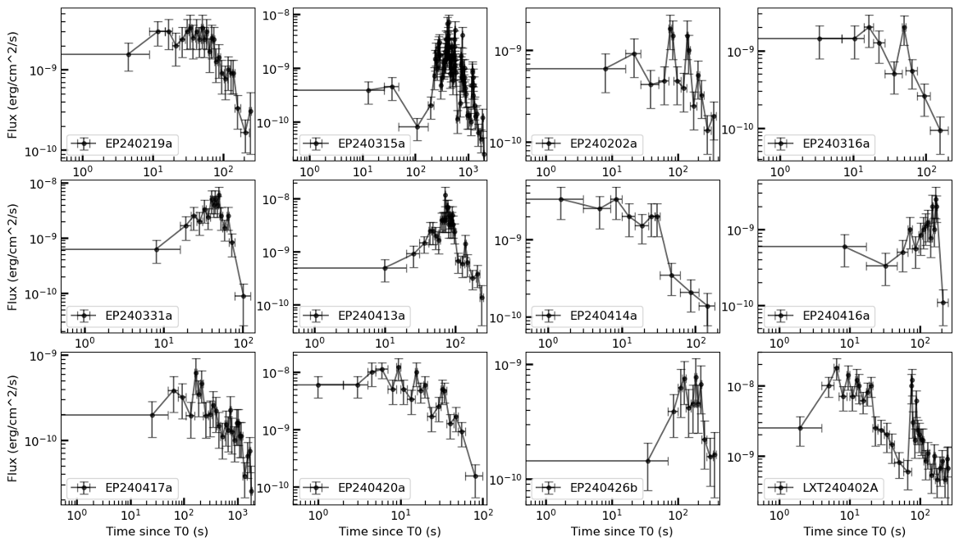
Example light curves of EP fast transients
only ~ 1/3 have hard X-ray/gamma-ray counterparts as GRBs；
what are the other 2/3?

Slide 20
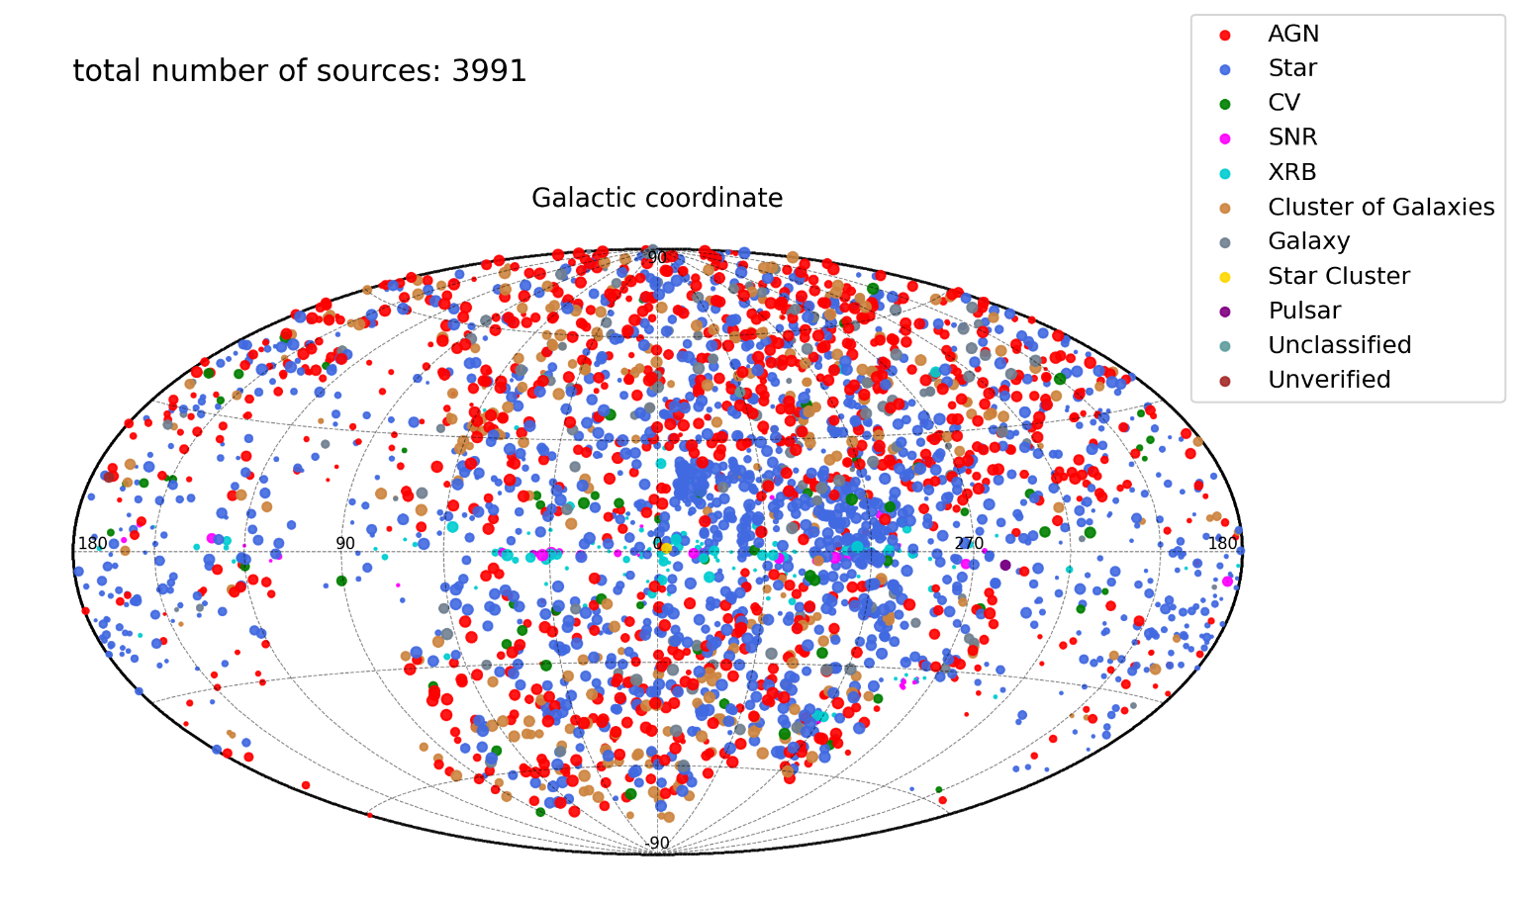
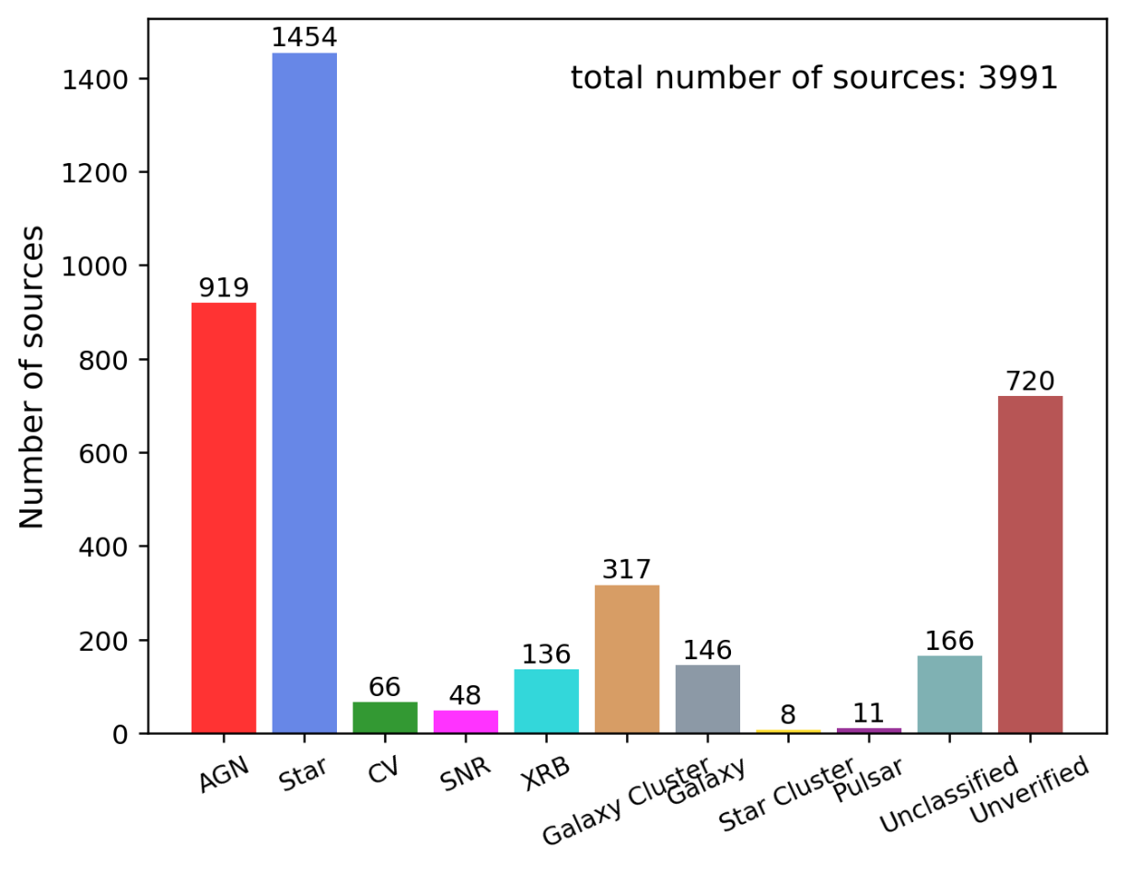
Statistics on X-ray sources detected with EP-WXT
WXT
            Known bright sources detected: ~5000
    Transients：> 44 high S/N (> 100 low S/N)
    Stellar flares：340
FXT
            More than 13,000 new sources found
Alerts
            More than 50 GCN+Atel alerts

Slide 21
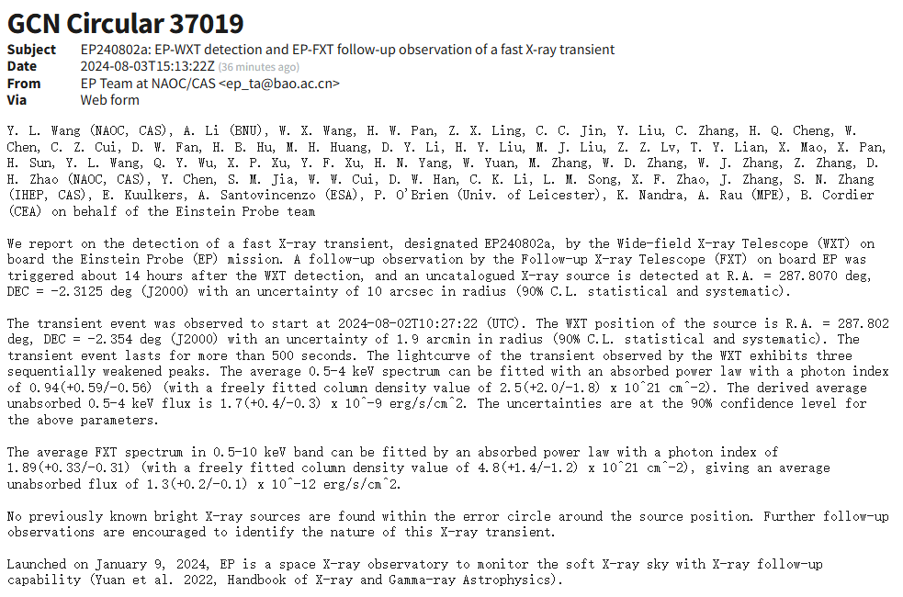
Detection of transients on a daily basis
3 transients found by EPSC on Aug. 3rd:
WXT detects two transients EP240802a (GCN 37019) and EP240802b
FXT also detects a new transient during the follow-up observation of EP240802a

Slide 22
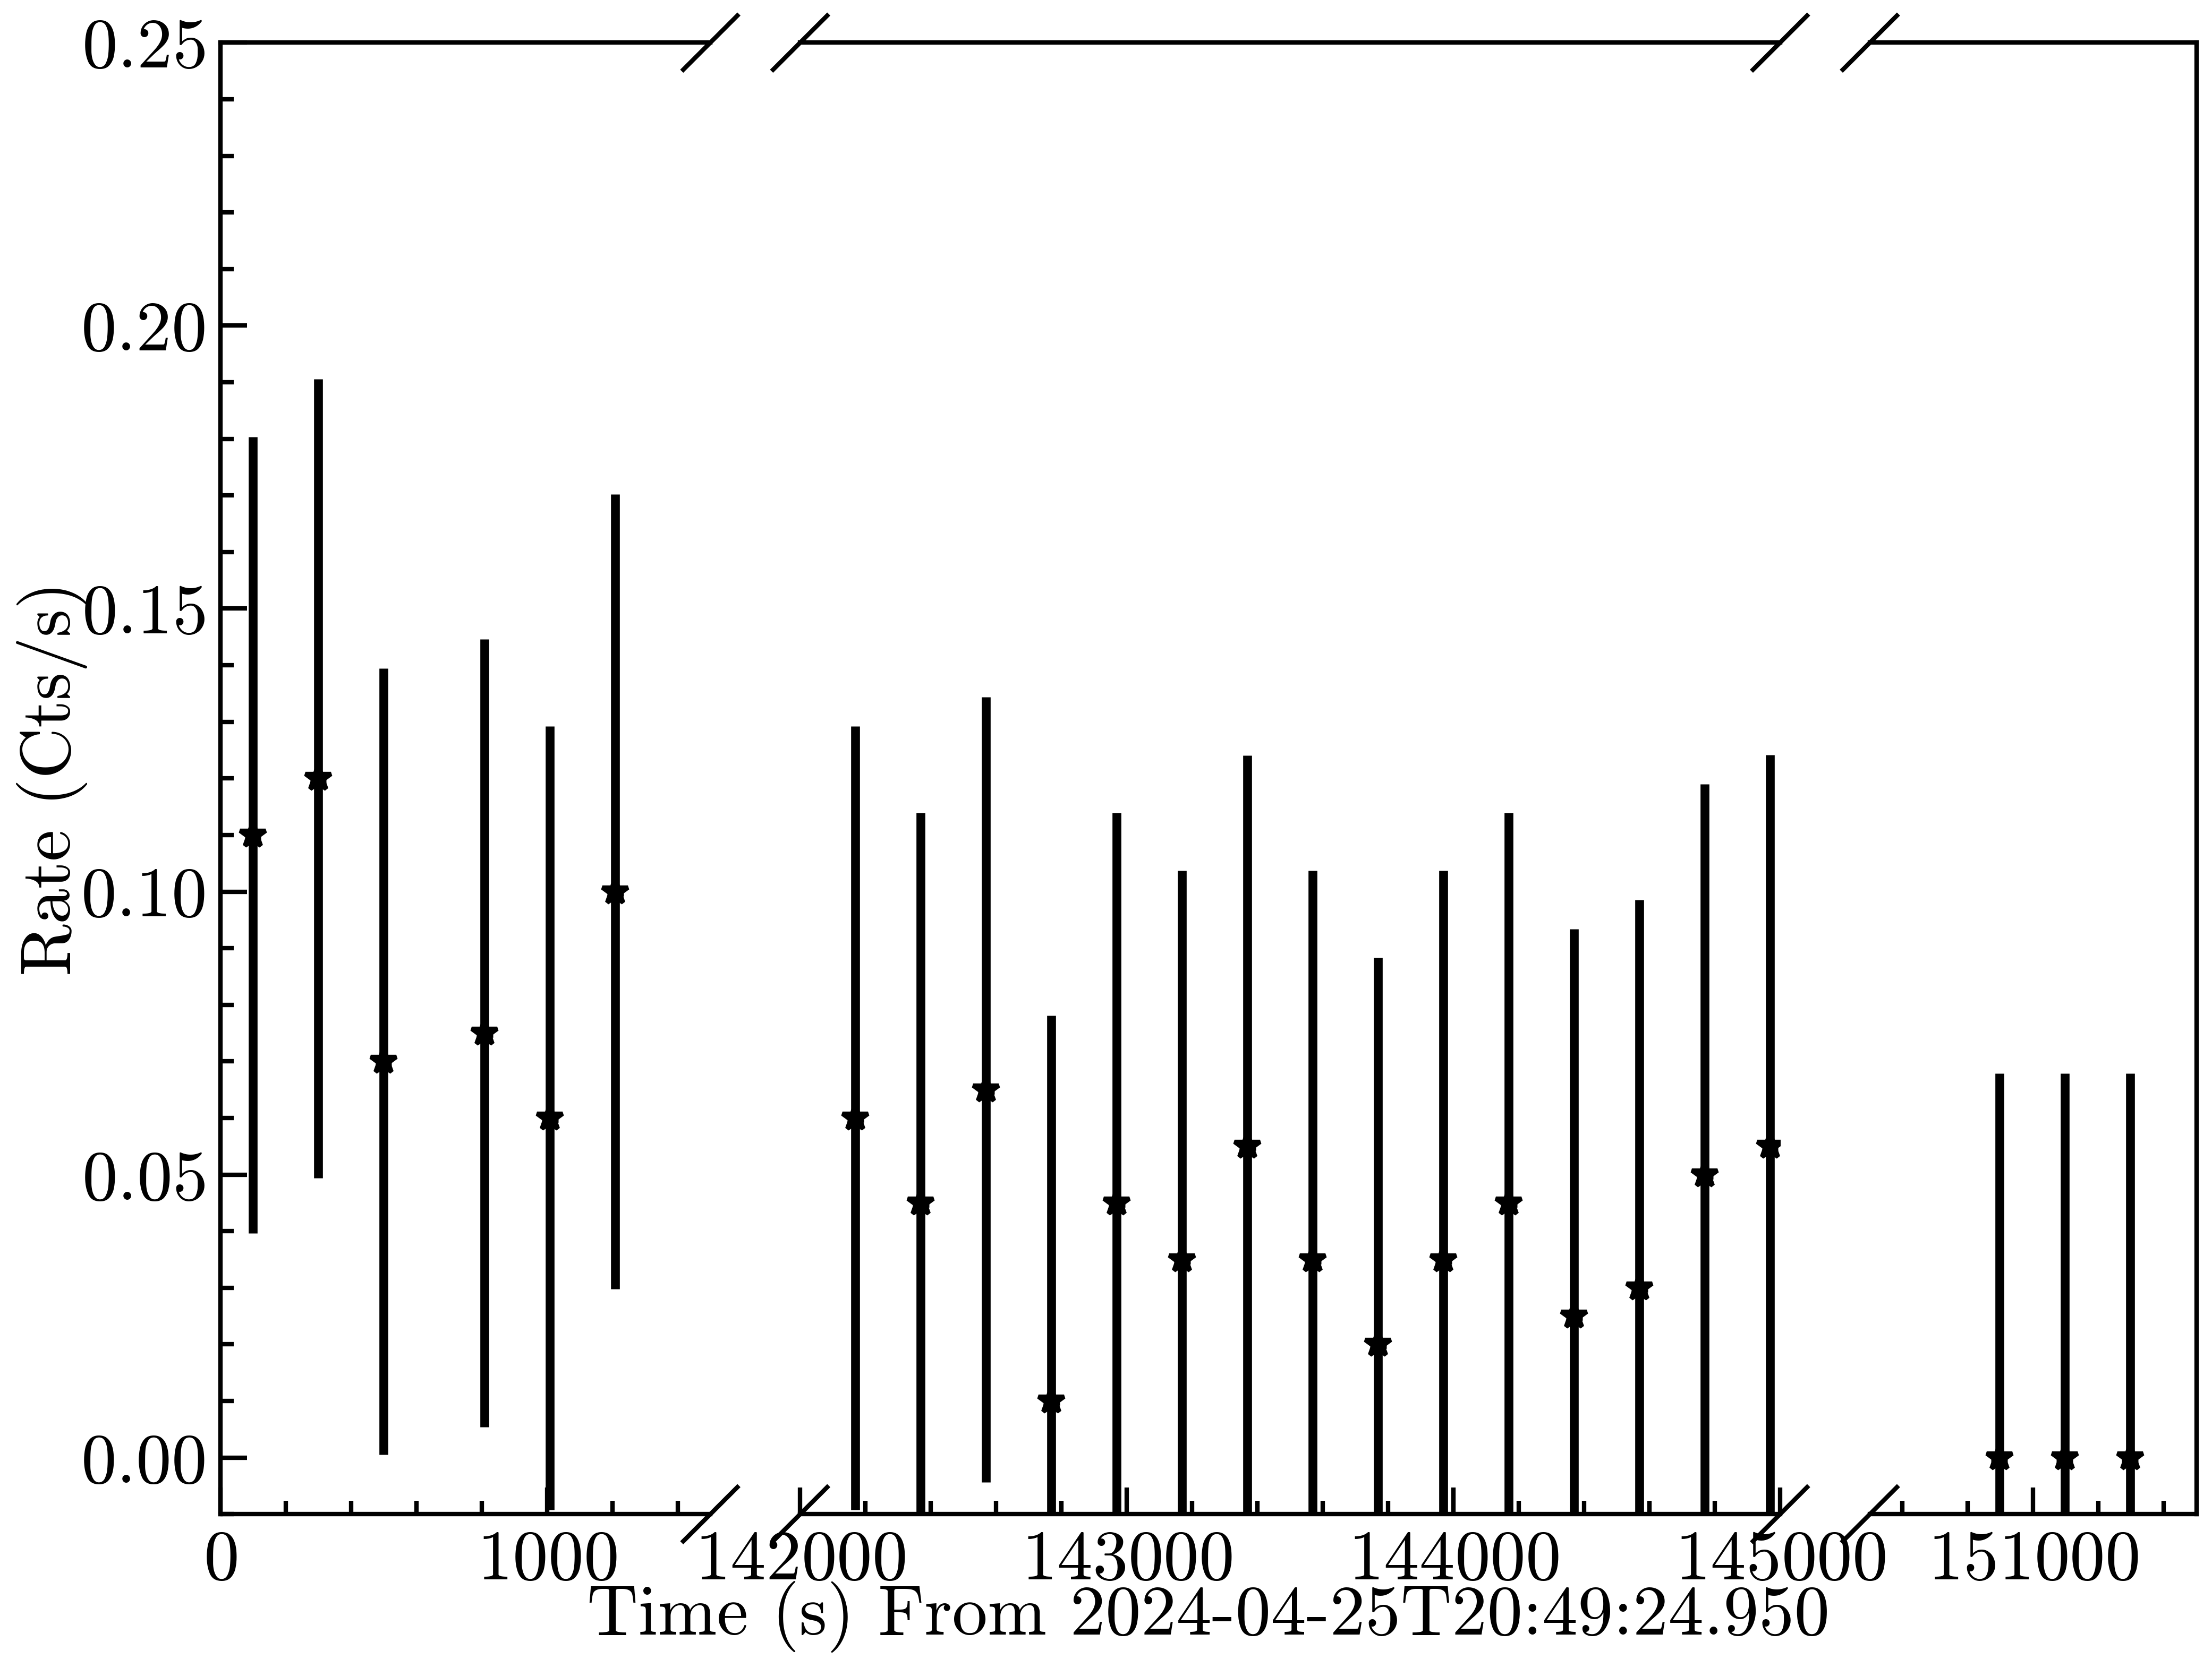
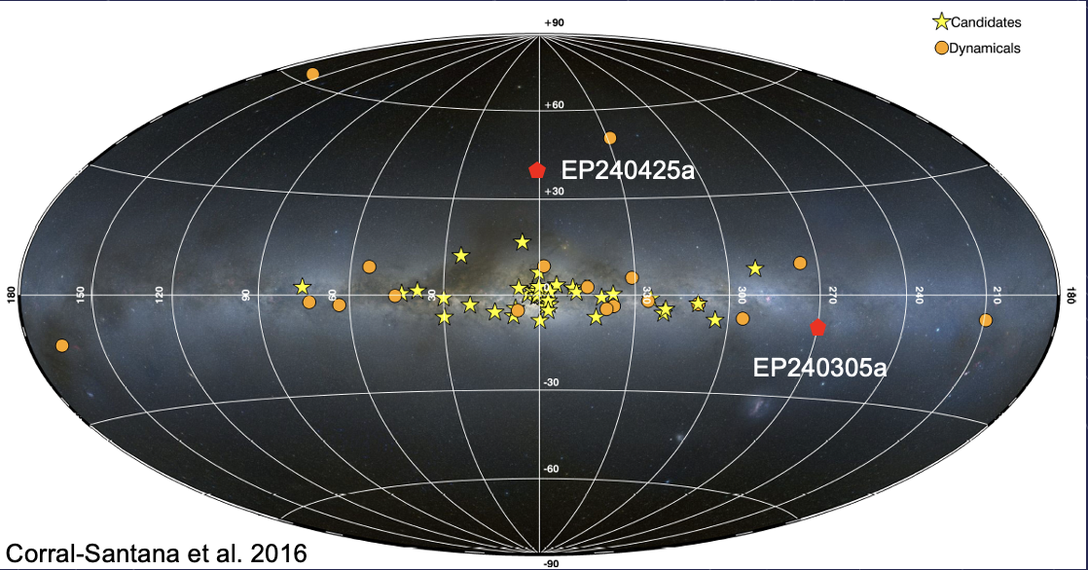
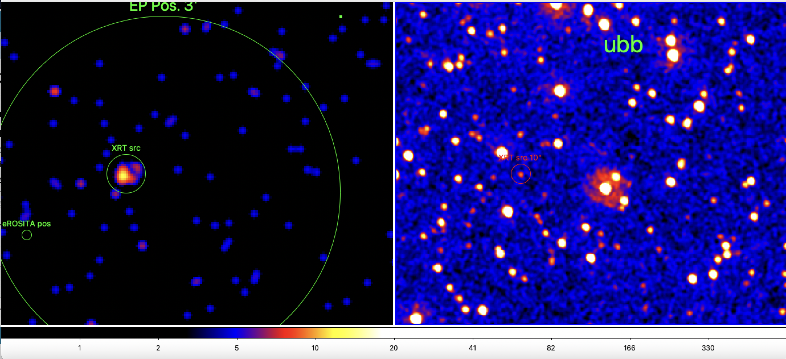
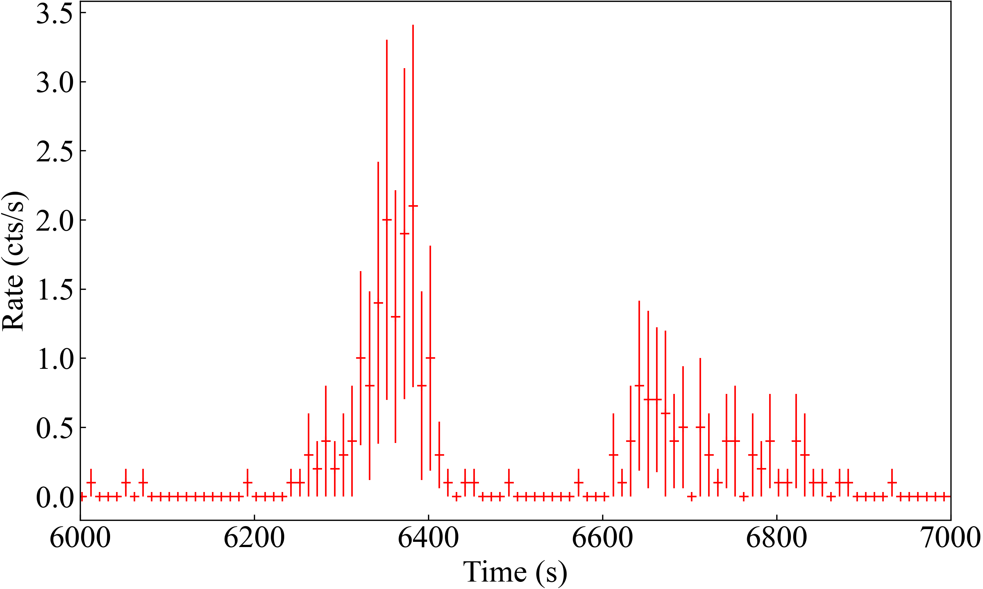
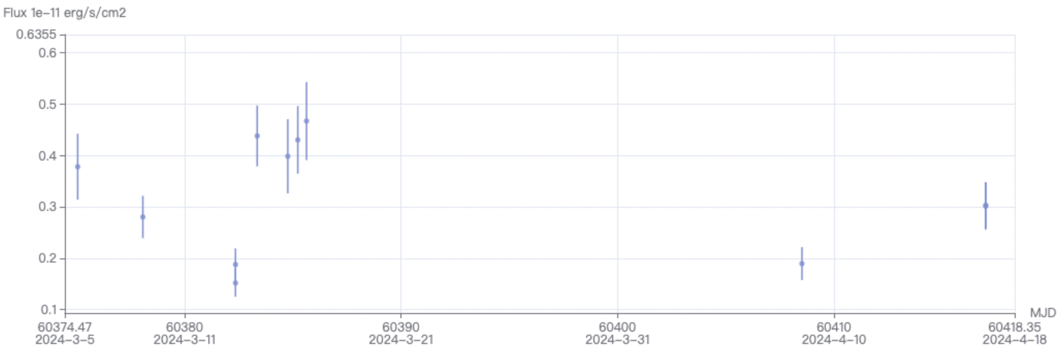
Galactic transients
WXT LC
EP240309a
A bright UV source and highly variable in optical (ATel #16554), MeerKAT obs. (ATel #16572)
a magnetic CV- intermediate polar
orbital period 3.76 hr, white dwarf spin 3.97min
(Potter 2024 MNRAS)
WXT LC
ATeL #16514
Swift/XRT
Swift-UVOT
late-A/early-F type star ACTA radio detection (ATel #16555)

Slide 23
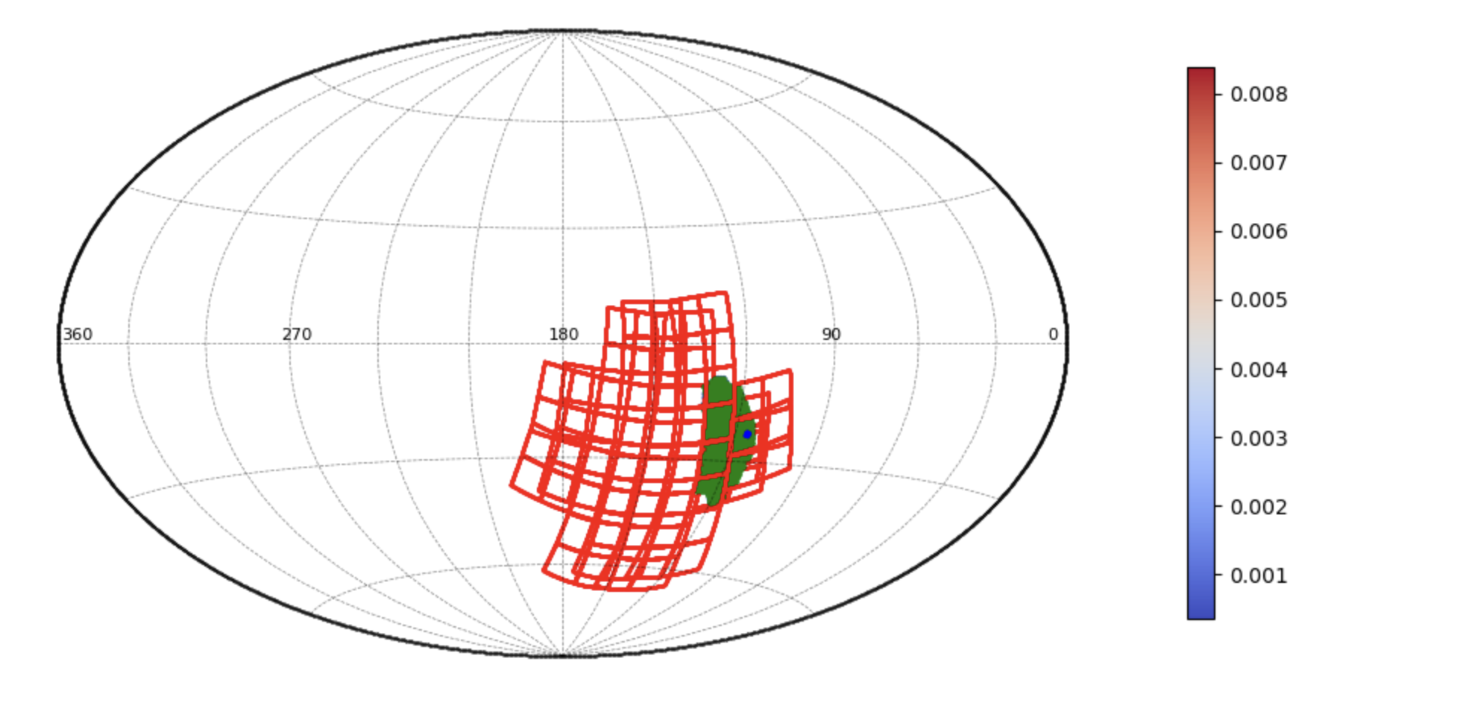
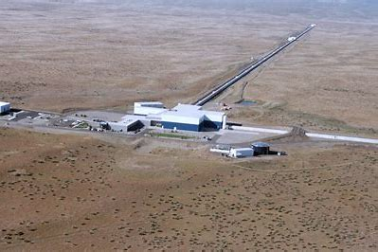
Search for potential X-rays from GW event S240422ed
On April 22, GW event NS+BH (>99%), 214 +/- 64 Mpc
EP observations: started ~ 3 hrs after GW trigger (yet to be improved)
Covered with WXT and set X-ray flux upper limits (GCN: 36270, 36277, 36282)
Searched >100 galaxies with FXT
Hu 2024 in prep.

Slide 24
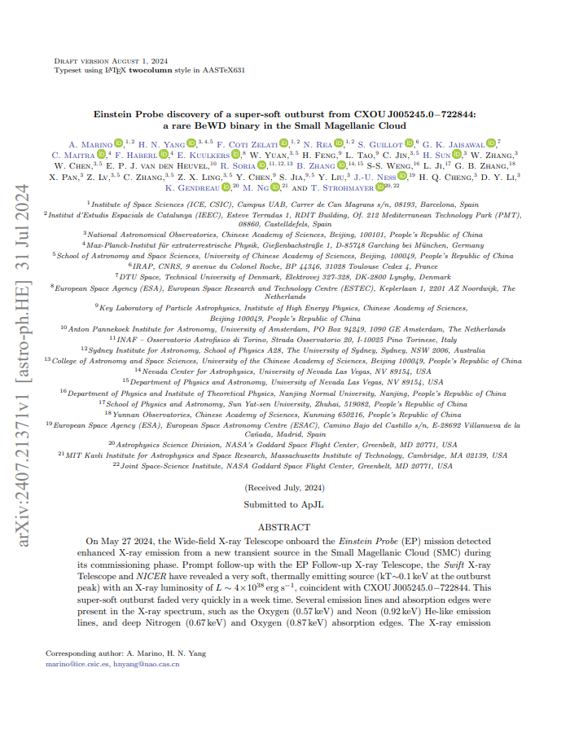
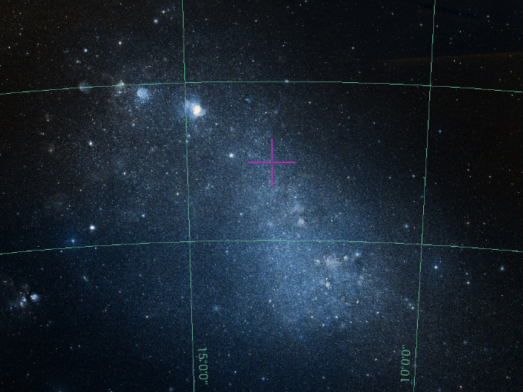
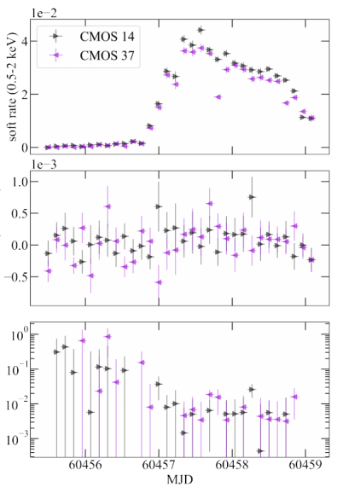
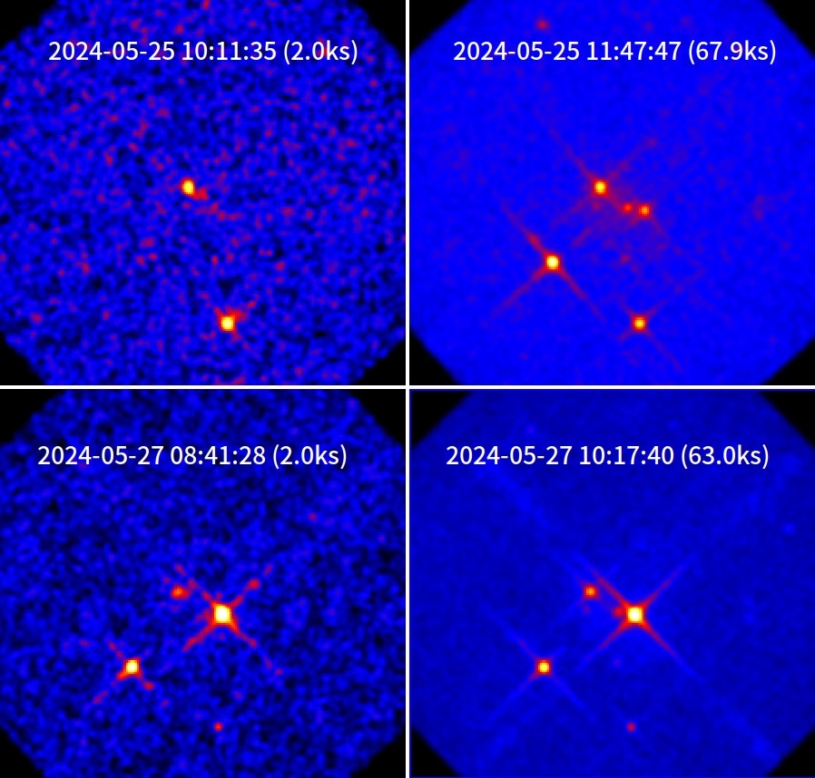
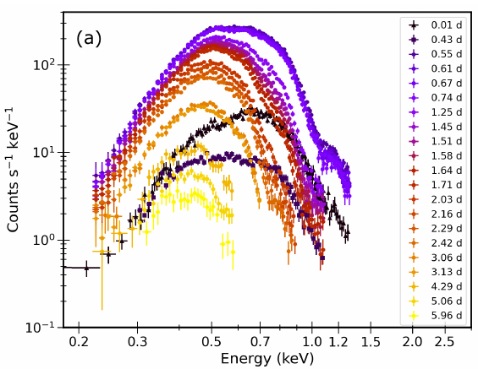
EP detects an outburst in Small Magellanic Cloud
CXOU J005245.0-722844 a weak Chandra source
WXT detected its first X-ray outburst (Atel#16631)
also by Swift/XRT (ATeL# 16633), follow-up by NICER (ATeL# 16636)
a possible rare Be-WD binary system
submitted to ApJL (arxiv:2407.21371)
Super-soft spectrum

Slide 25
Conclusion
Since launch on January 9, EP’s performance verifications & calibrations have completed
Spacecraft & instruments working as expected
> 30 X-ray transients (>100 faint ones) were detected
Nominal science operations just started yesterday (practically)
A newcomer with great scientific potential in time-domain X-ray astronomy
http://ep.bao.ac.cn
https://www.esa.int/Science_Exploration/Space_Science/Einstein_Probe_factsheet
Thanks to the entire community and other mission teams for the welcoming, enthusiasm and help to EP mission,
particularly follow-ups with Swift, NICER, Chandra, XMM, etc. and ground-based optical and radio telescopes around the world …..

Slide 26
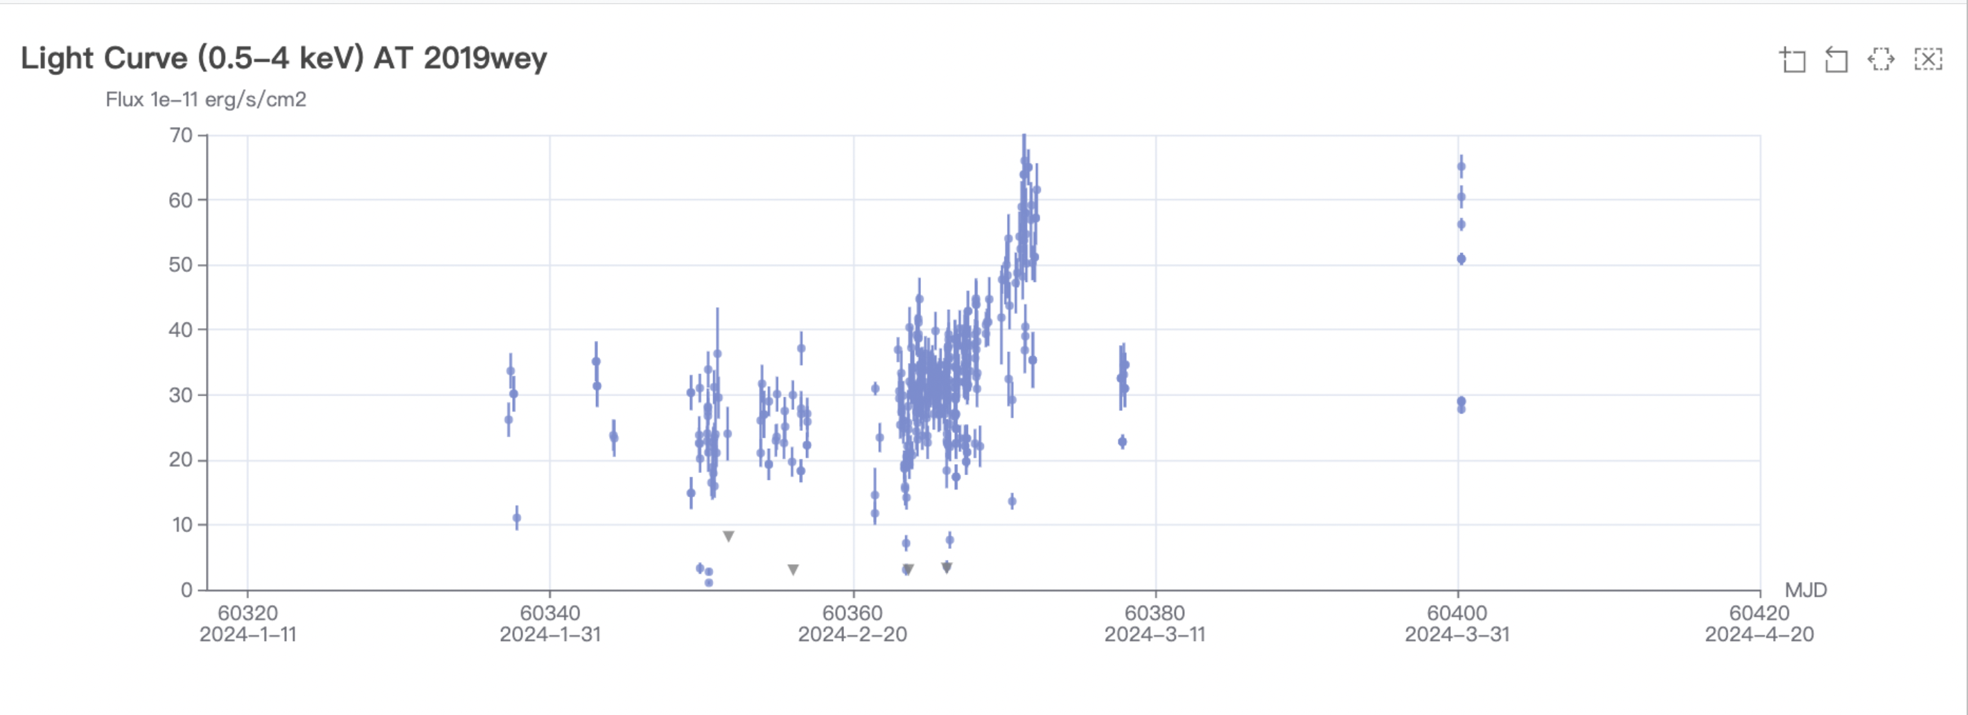
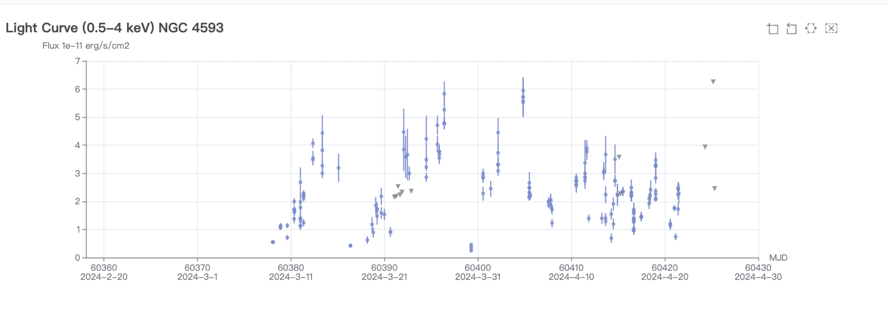
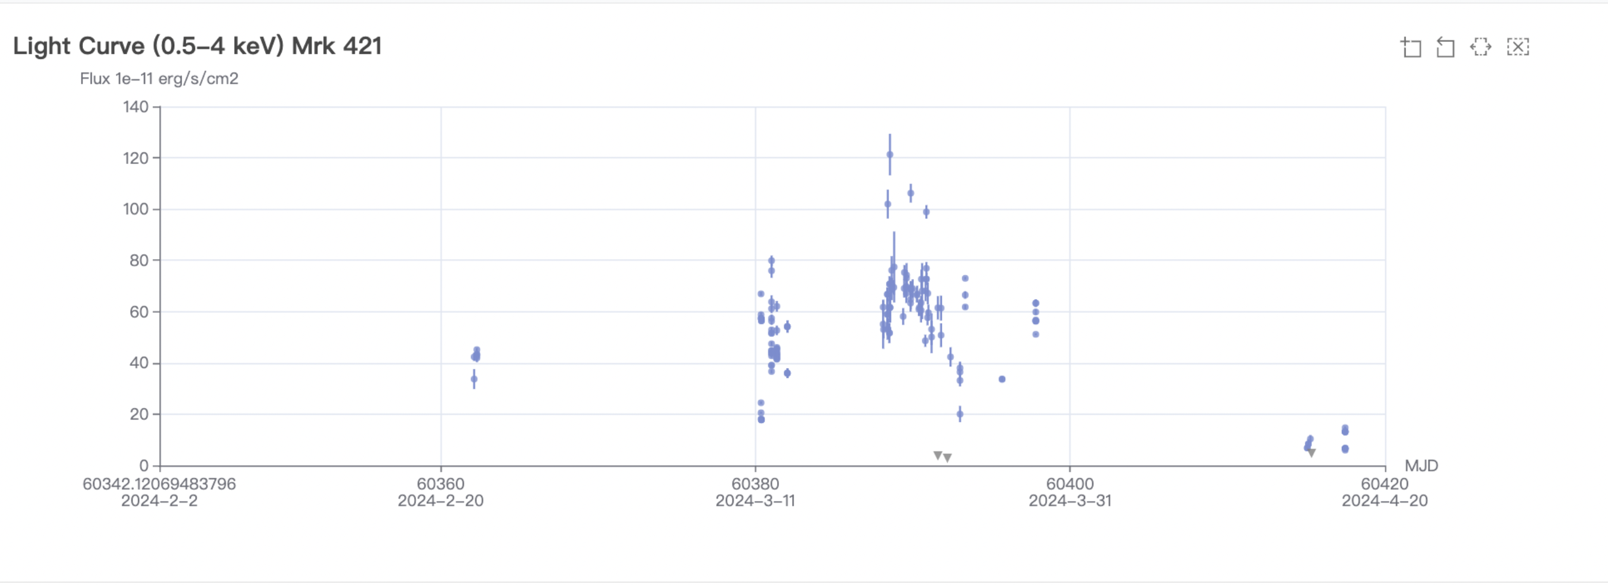
Monitoring of known X-ray sources
X-ray binary
Seyfert galaxy AGN
blazar

Slide 27
Perspectives on GRB research
About 2/3 of the EP fast transients have no significant gamma-ray counterparts
  detecting GRB in soft X-ray: follow on the legacy of Beppo-SAX and HETE-2
  previously scarcely detected population, X-ray flash, X-ray rich GRB, ….
Soft X-ray prompt emission (possible new insight into GRB central engine activity)
  more extended (longer T90)
  complicated structure, multiple peaks
EP240315a: demonstrating the potential in detecting high-z GRB
  faint flux end of known high-z GRB, detectable at z~7.5 (Liu Y. et al. 2024, Levan et al. 2024, Gillanders et al. 2024)

Slide 28
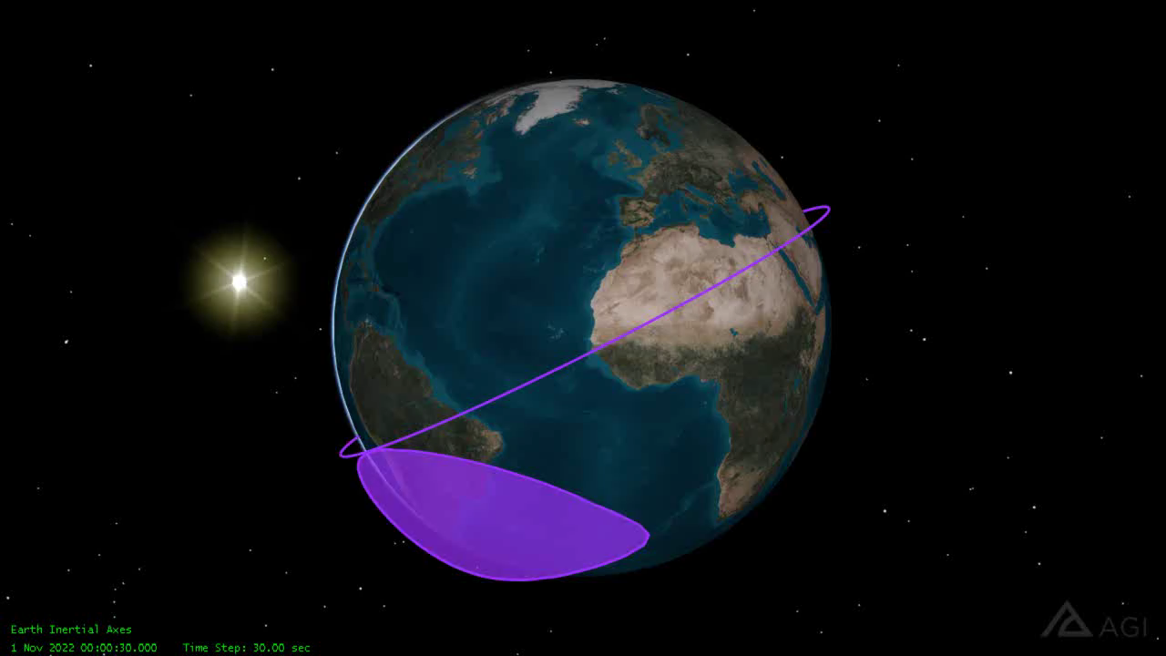
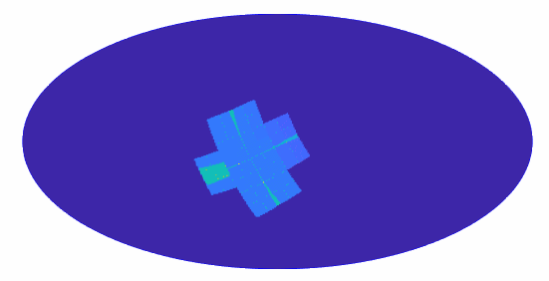
Observation modes
Circular orbit
  Height 592km, period 96min
  inclination angle 29 deg.
Observation modes
  Survey (primary WXT)
  Autonomous follow-up (FXT)
  ToO (FXT, WXT)
  Calibration
WXT survey mode
  Pointing to night sky
  3 pointings/orbit, ~20min each
  ~ 1/2 sky covered in 3 orbits (~ 5 hr)
  Whole sky coverage in ½ year
  FXT pointed to pre-selected targets
Equatorial coordinates
Notes:
~ 45 snapshots per day
FXT survey target observation (FSTO)

Slide 29
Alerts of transients, ToO & data
Transient alerts
  Onboard transient search and trigger unit
  Alert information quick downlink： minutes
    VHF (CNES/France)
    BD system (China)
  Alert information: release immediately to the community
    source position, flux, time, spectral parameter
ToO command uplink
  Normal (S-band): < 1 day
  Time critical (BD) < 10 min
Science data
  X-band telemetry: it takes about a few hours to reach EPSC
  Will be made public (community outside EPST) after proprietary periods
  Non-ToO data: one year
  ToO by EP science team: 6 months
  ToO by guest observers: released immediately

Slide 30
Alerts of transients, ToO & data
Transient alerts
  Onboard transient search and trigger unit
  Alert information quick downlink： minutes
    VHF (CNES/France)
    BD system (China)
  Alerts info: release immediately to community (we’re working toward reducing latency)
    source position, flux, time, spectral parameter
ToO command uplink
  Normal (S-band): < 1 day
  Time critical (BD) < 10 min
Science data
  X-band telemetry: it takes about a few hours to reach EPSC
  Will be made public (community outside EPST) after proprietary periods
  Non-ToO data: one year
  ToO by EP science team: 6 months
  ToO by guest observers: released immediately

Slide 31
EP data and information flows
EPSC

Slide 32

EP main web page at NAOC

Slide 33




Main science objectives
Systematic survey of soft X-ray transients and variability of X-ray sources with unprecedented combination of sensitivity and cadence
Discover otherwise quiescent black holes at almost all astrophysical mass scales and other compact objects by capturing their transient X-ray flares
Detect and localise the electromagnetic-wave sources of gravitational-wave events by synergy with gravitational-wave detectors

Slide 34







Wide-field X-ray Telescope
one module
Lead of LE mirrors
Chen Zhang (NAO/CAS)
WXT chief designer
Xiaojin Sun (SITP/CAS)
Flight model 17kg
mirror assembly
detector array
Instrument scientist &
lead of CMOS
Zhxing Ling (NAO/CAS)
MA engineer
Yanfeng Dai (NAO)
MPO plates (developed by NNVT jointly with NAO/CAS)
41mm x 41mm each
BI CMOS sensors
Time resolution 50ms
$Δ$E ~ 122eV @1.25keV

Slide 35







Follow-up X-ray Telescope (FXT)
IHEP/CAS + ESA + MPE
2 Wolter-I mirror assemblies
  1 by ESA (Media-Lario, eROSITA design)
  1 by MPE (eROSITA FS)
X-ray cameras (IHEP)
  PN-CCD detector modules by MPE based on eROSITA tech.
FXT mirror assembly FM
(ESA/MediaLario/MPE)
PI: Yong Chen
(IHEP/CAS)
Camera lead:
Weiwei Cui (IHEP/CAS)
E2E test/calibration @ IHEP/CAS 100m beamline
FXT Delivered by IHEP team to MicroSAT on May 26
X-ray camera built @ IHEP/CAS

Slide 36





EP satellite
S/C developed @ MicroSat/CAS, Integration & tests
just before launch
acoustic test
thermal vacuum tests
thermal vacuum tests

